Slide 1
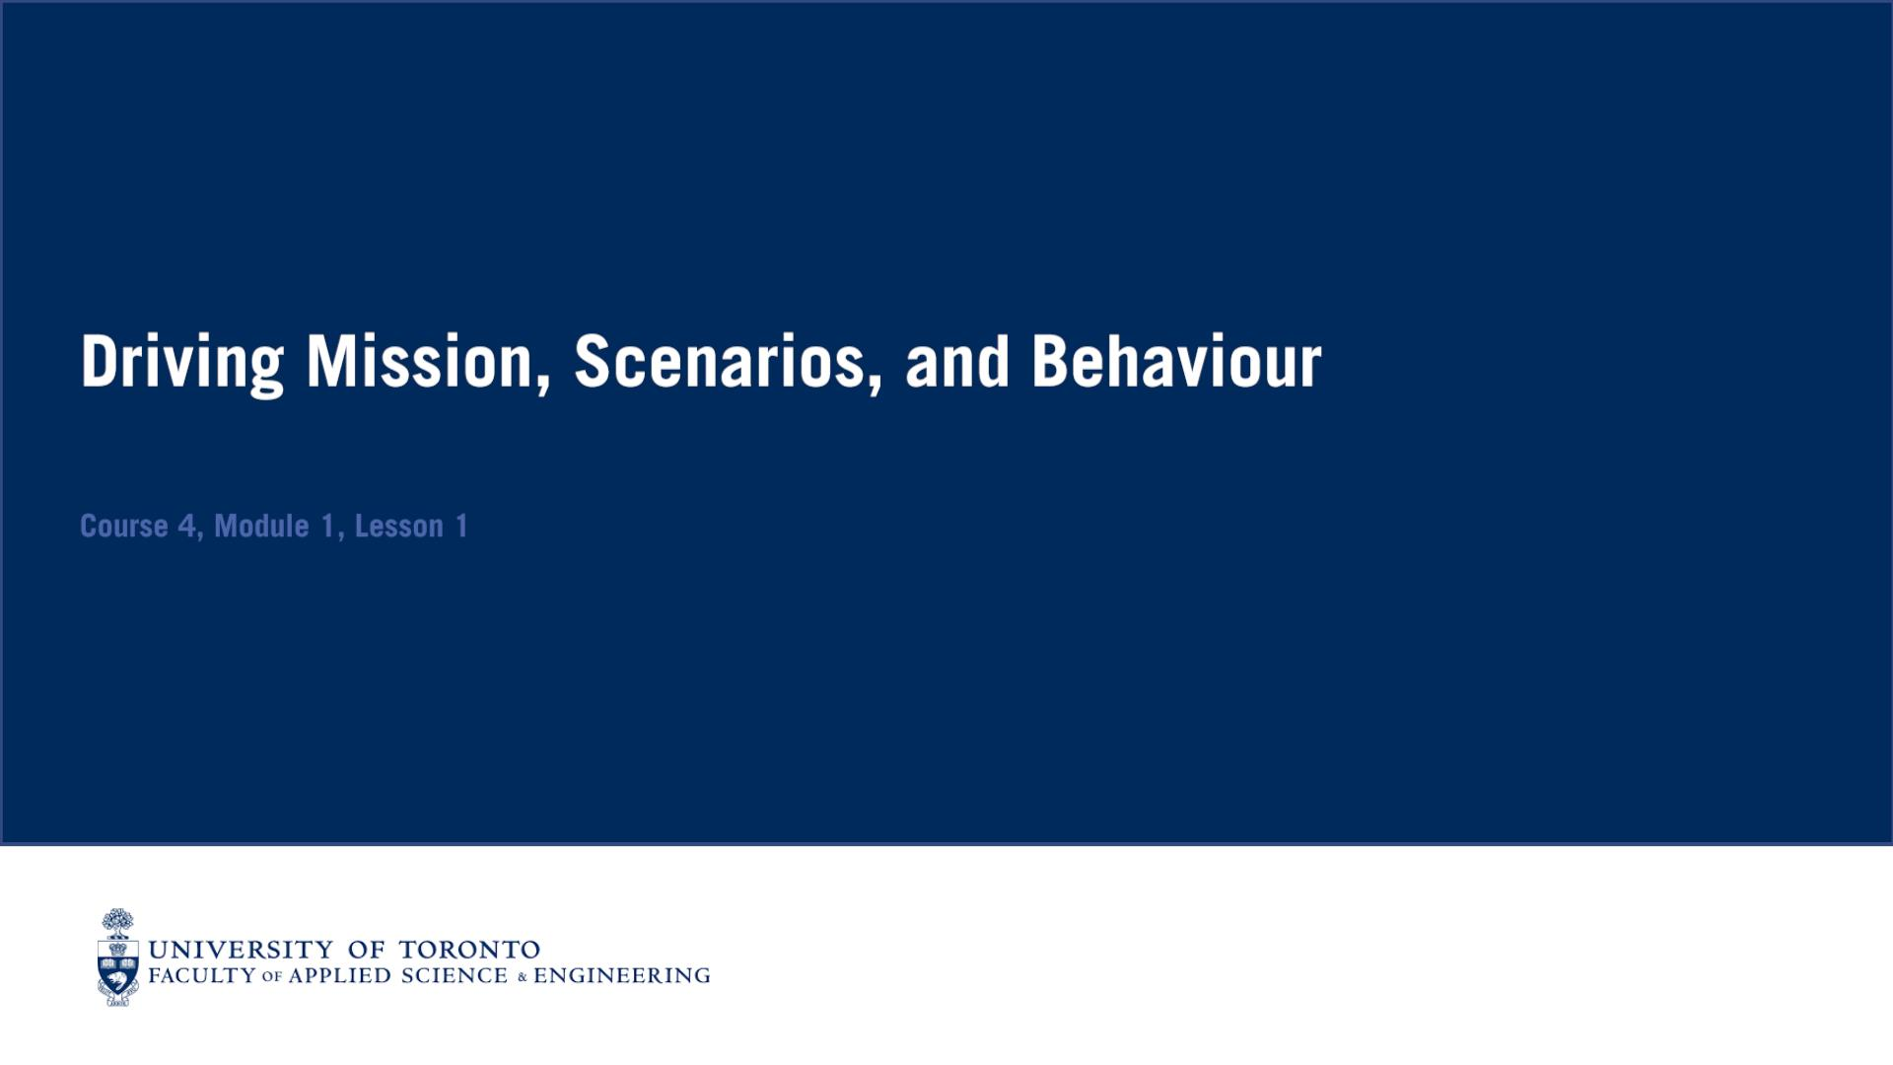

Slide 2
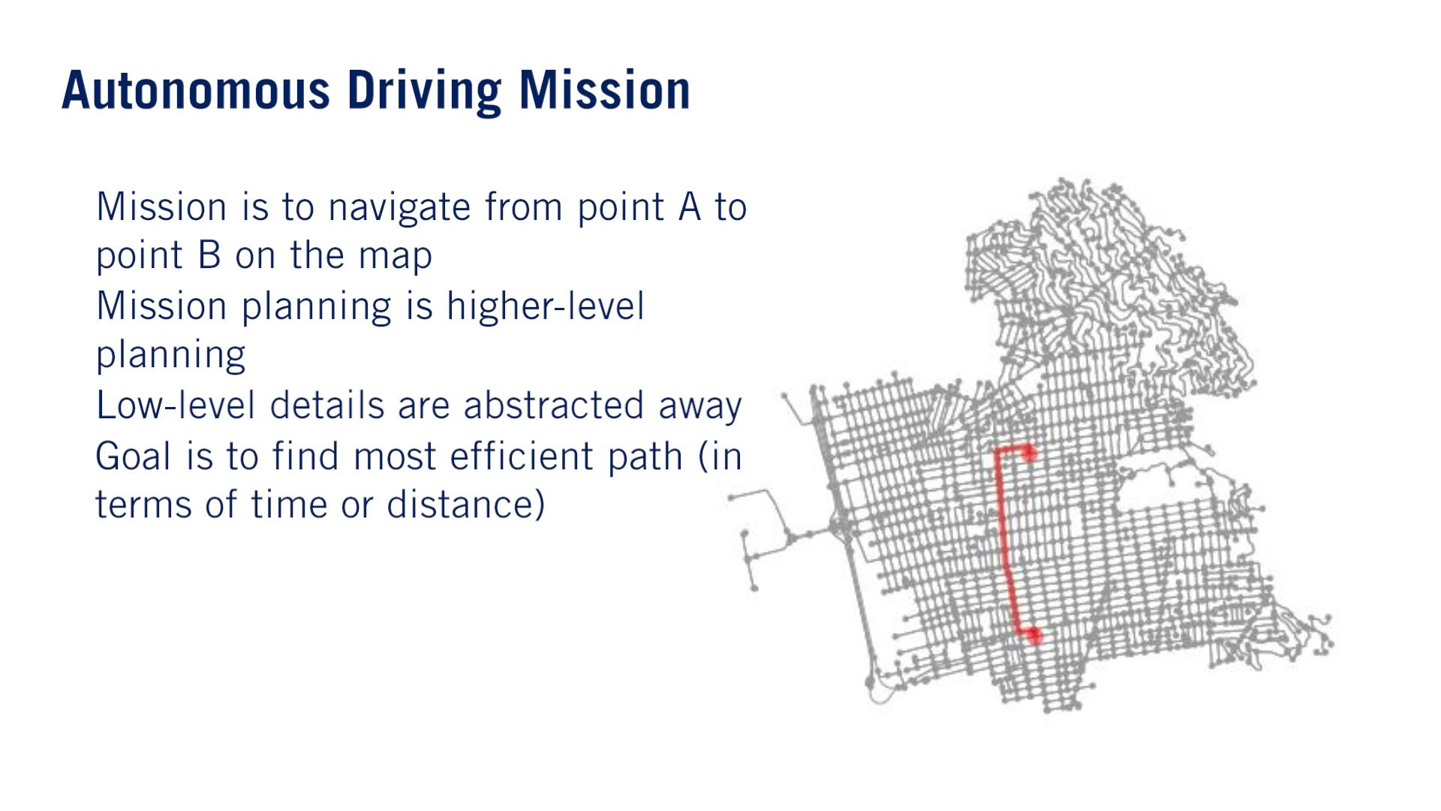
such as road structures, obstacles, and other agents on the road.
These lower level variables defined different driving scenarios.
•
•
•
•

Slide 3
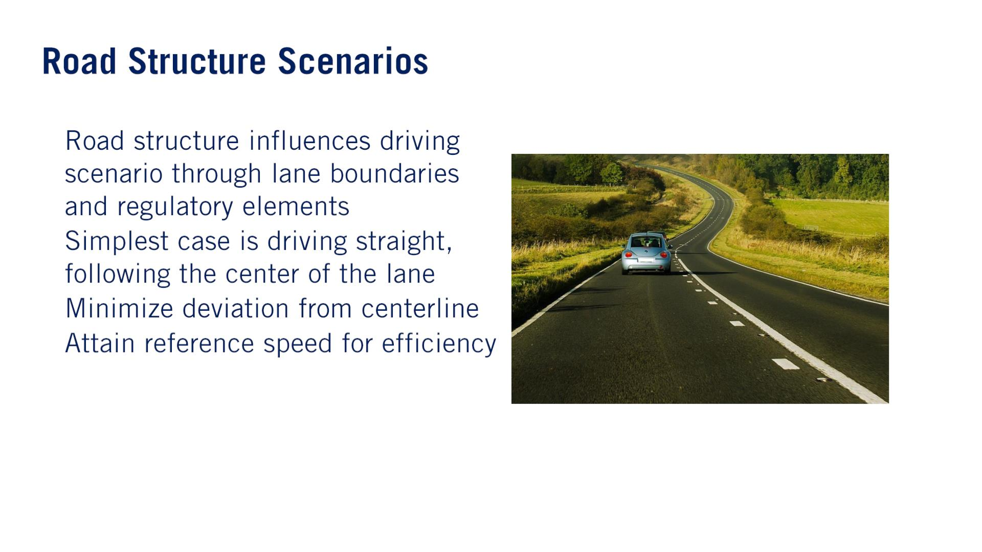
•
•
Lane Maintenance
•
•
Reference speed is often the speed limit.

Slide 4
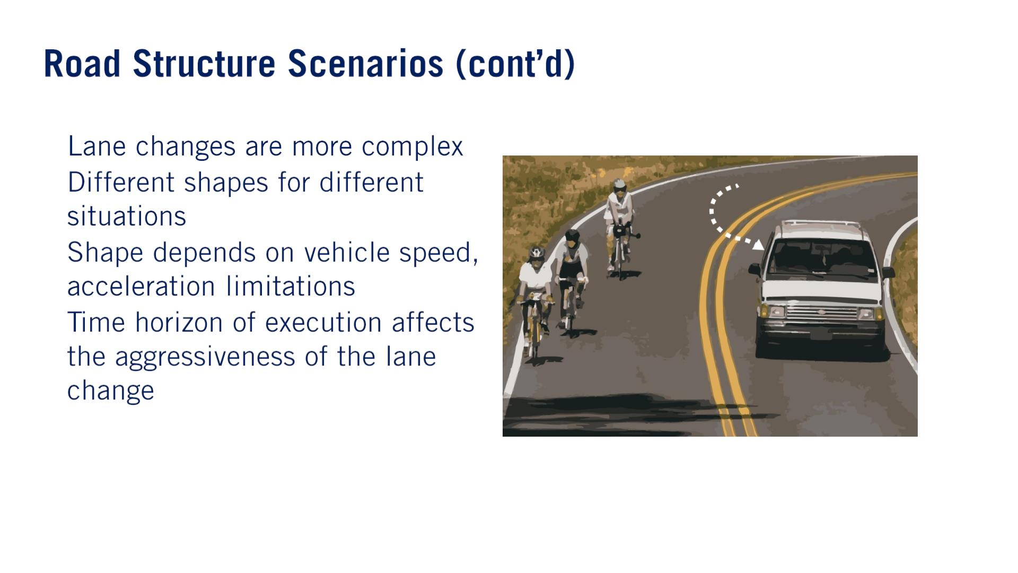
•
•
Shapeはレーンチェンジの軌道でしょう
•
•

Slide 5
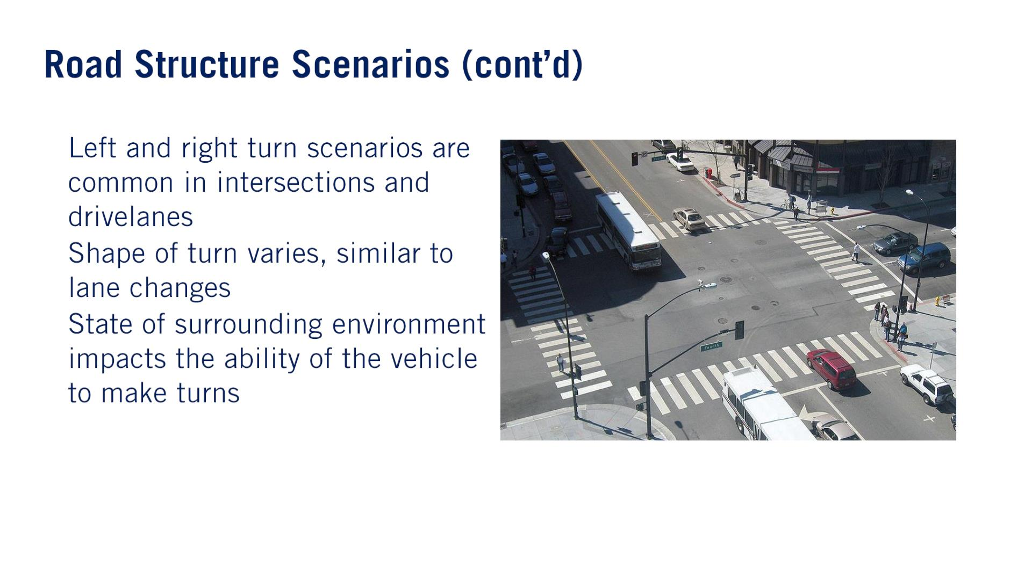
•
•
•

Slide 6
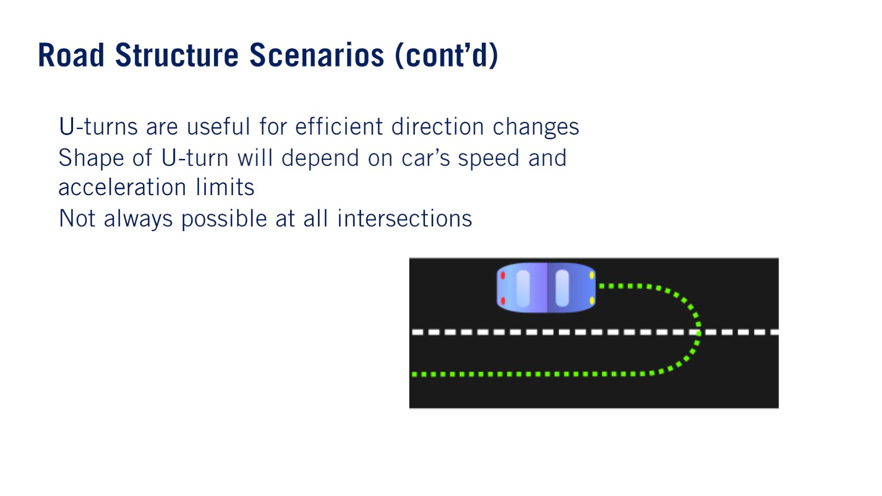
•
•
•

Slide 7
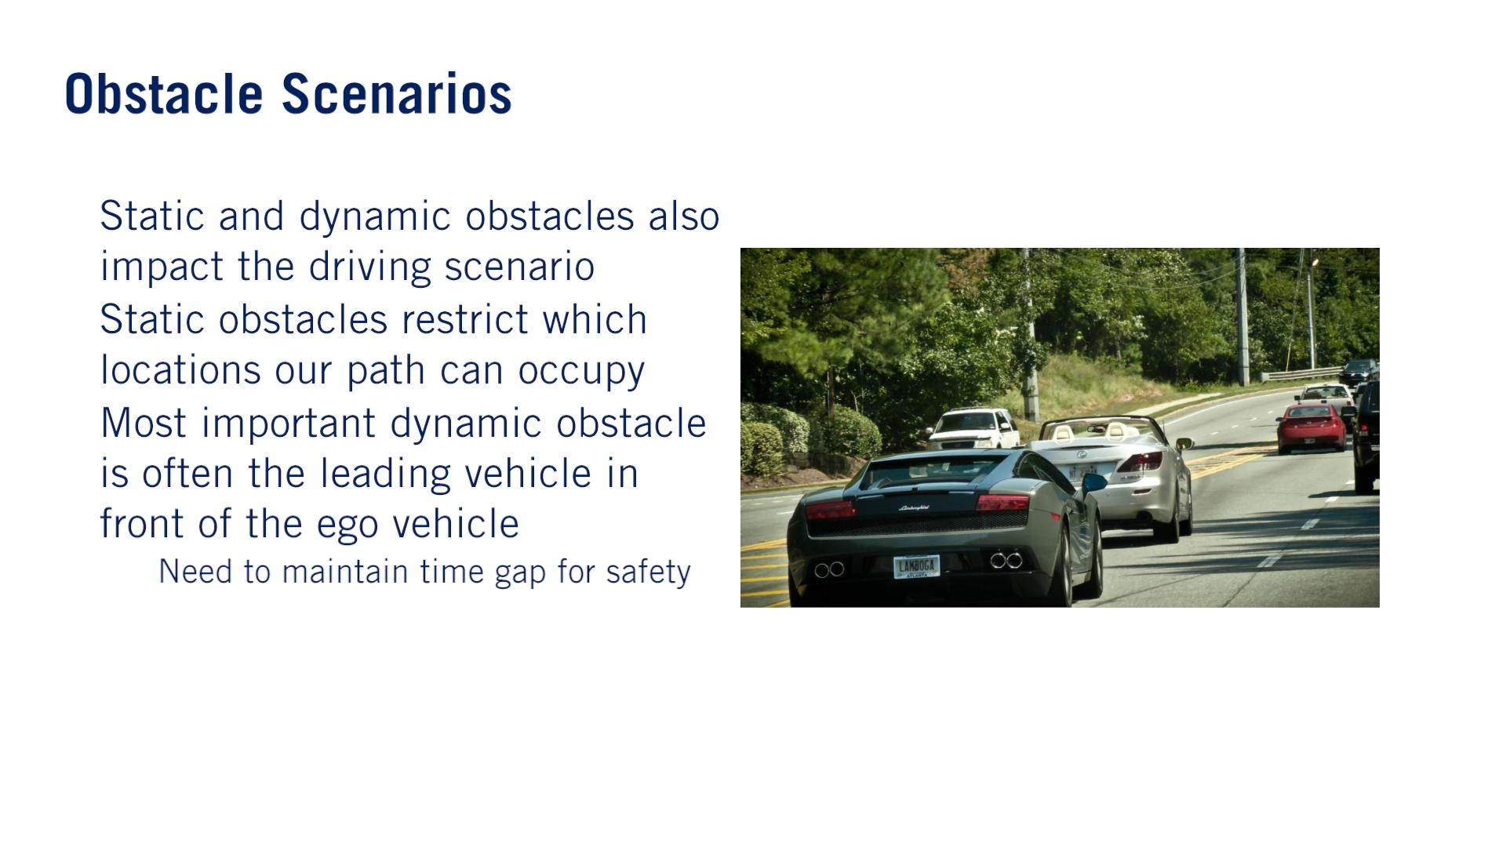
•
•
•
o
Time gap is defined as the amount of time until we reach the lead vehicle’s current position while maintaining our current speed.

Slide 8
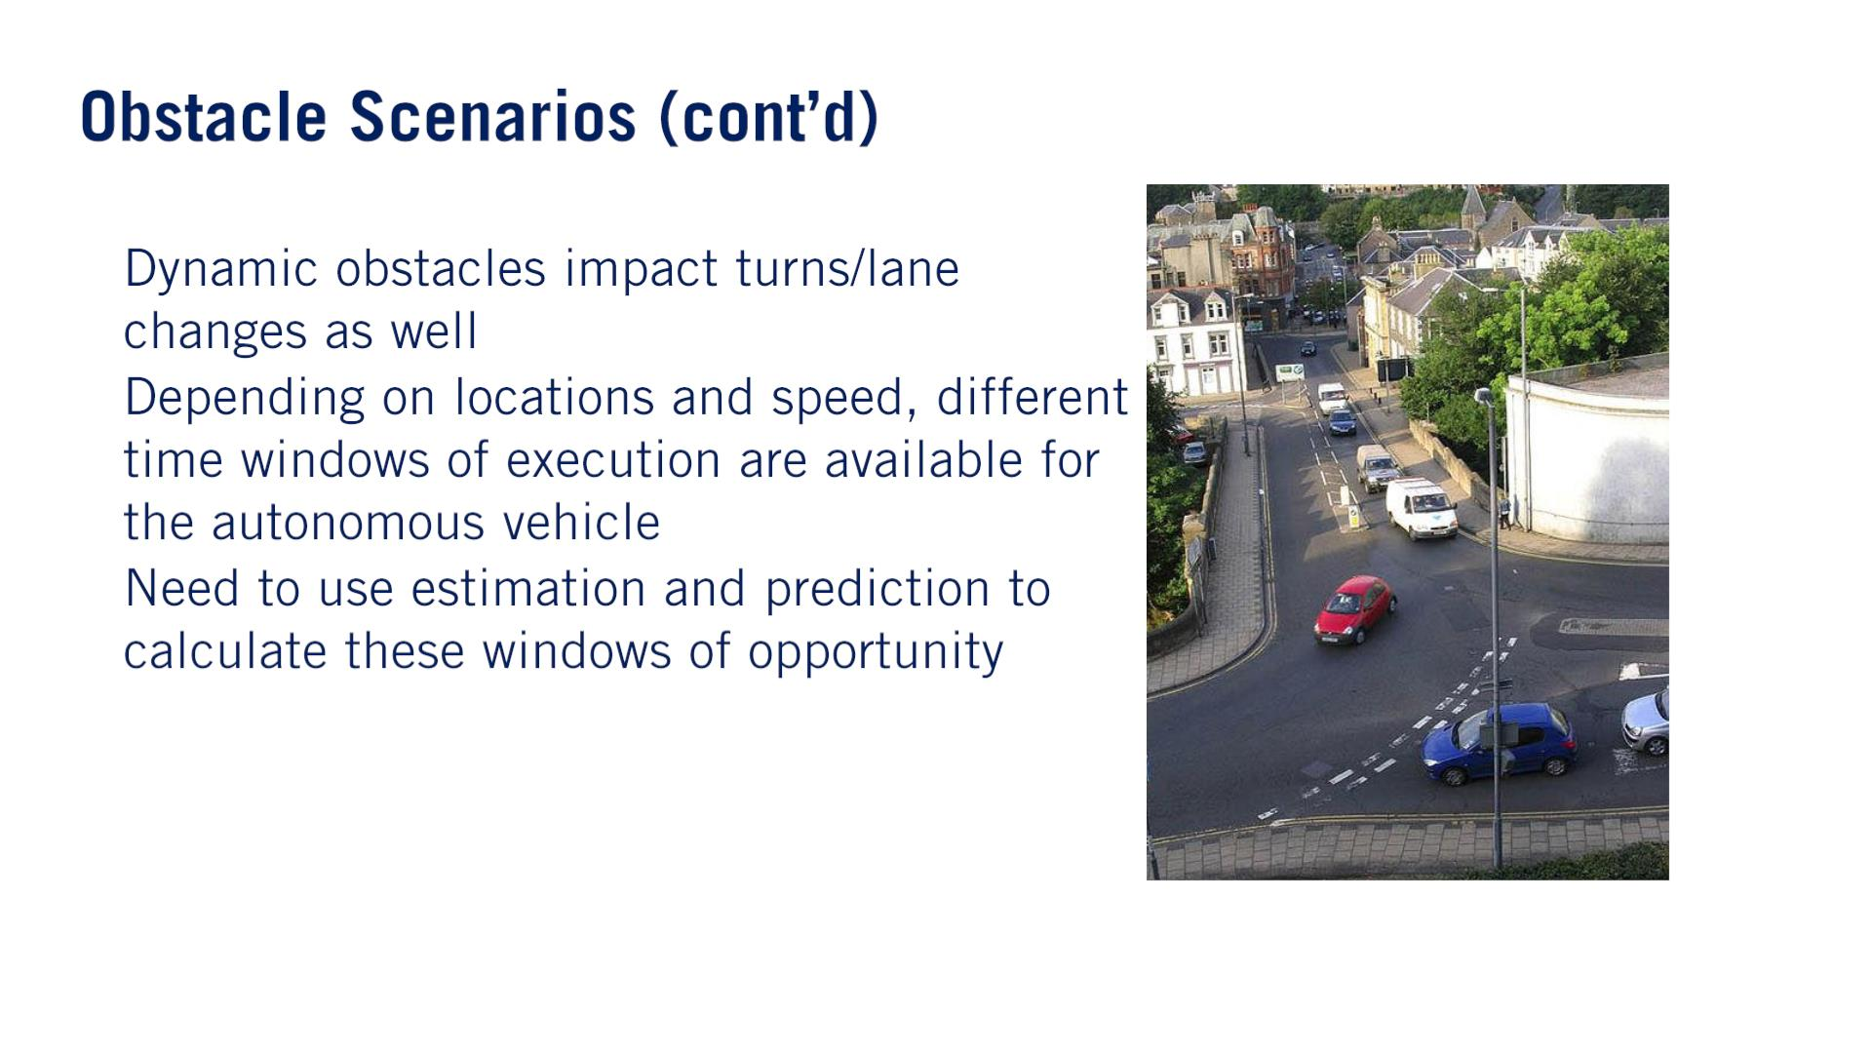
•
•
•
例えば交差点右折と合流路だ。

Slide 9
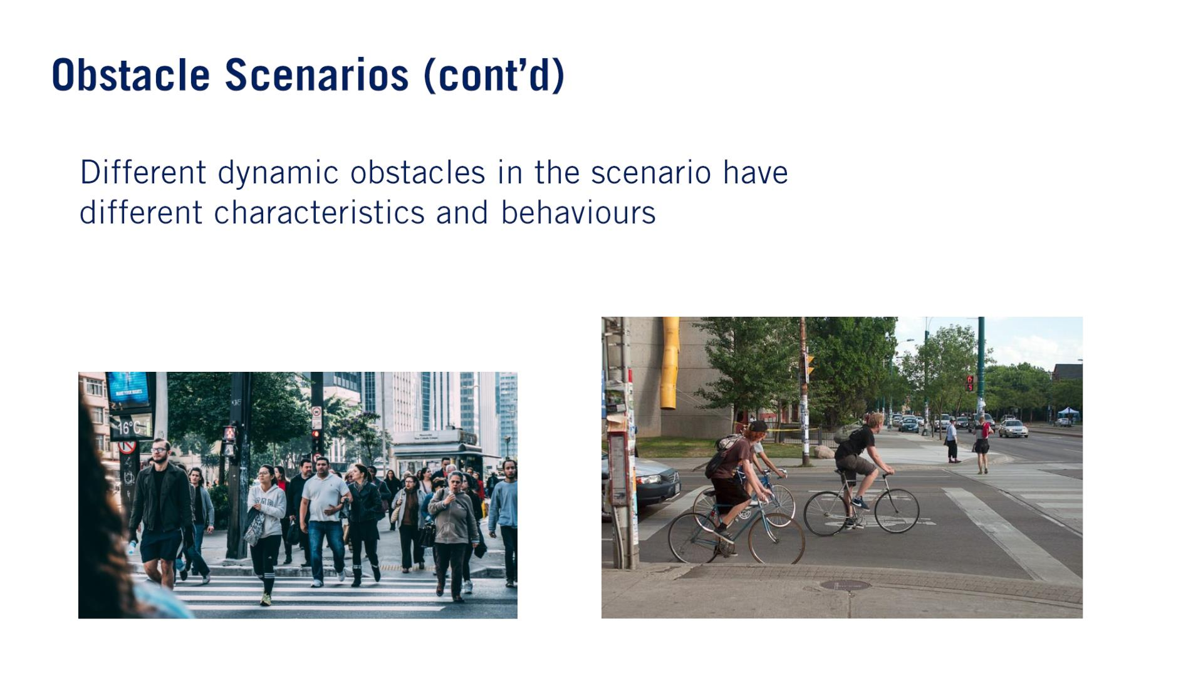
•

Slide 10
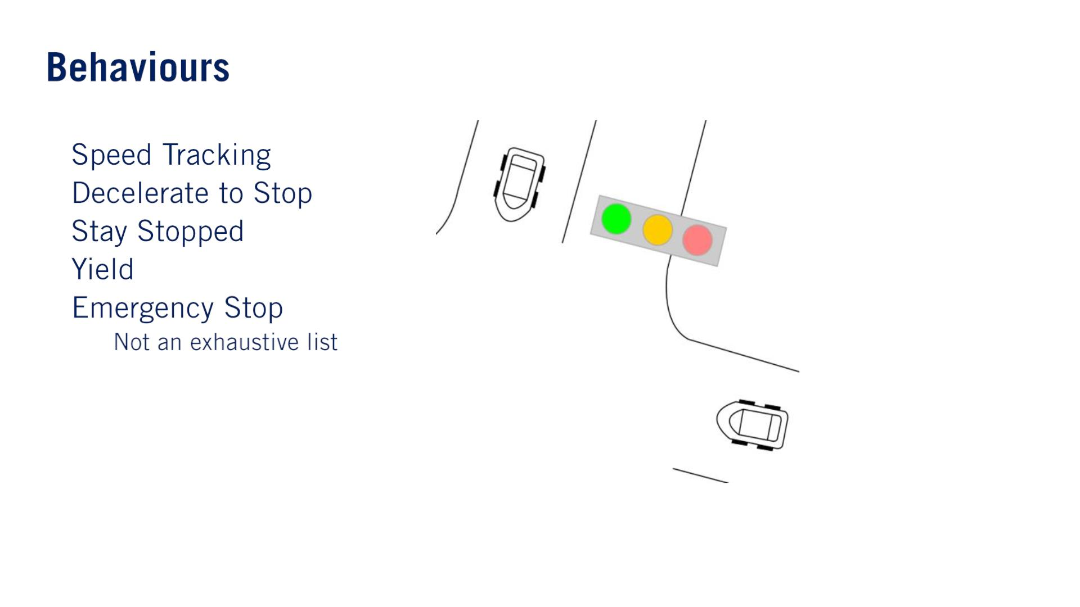
•
•
•
•
•
yield sign. ⽌まれ！
o

Slide 11
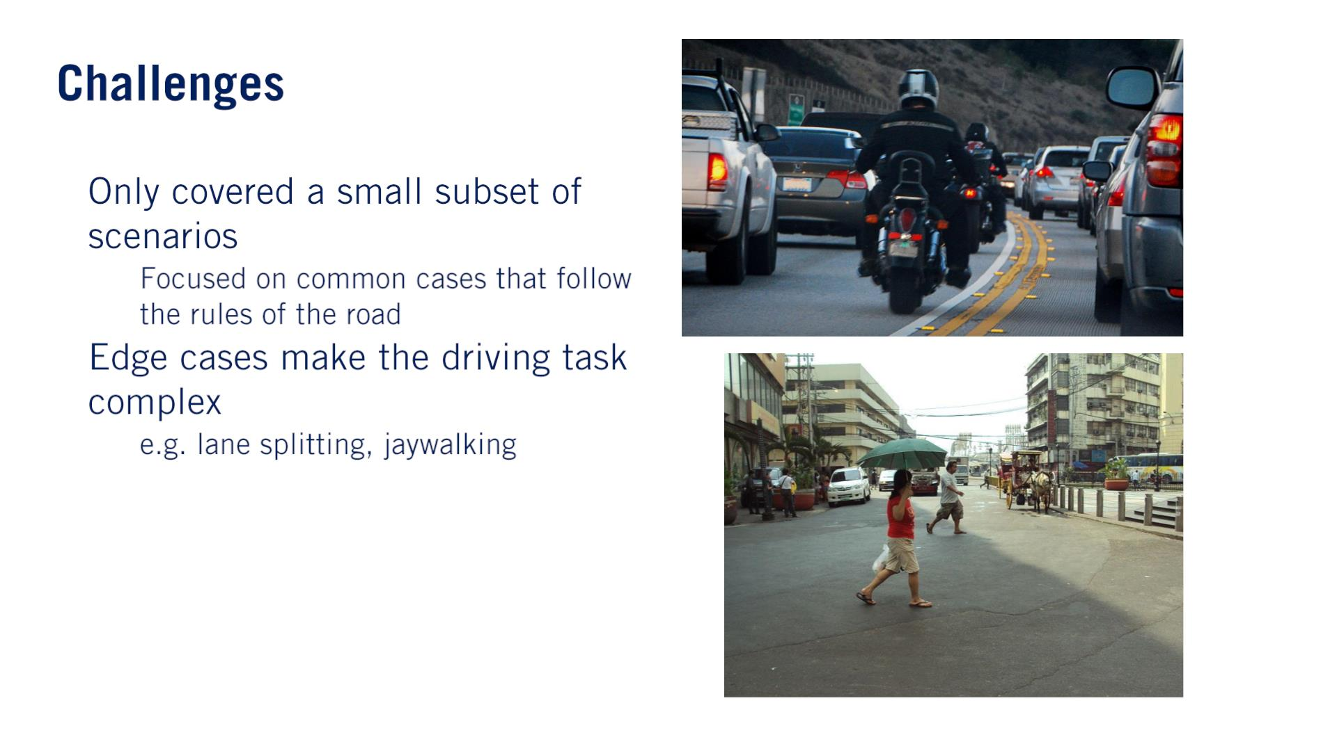
•
•
o
o
（バイク）

Slide 12
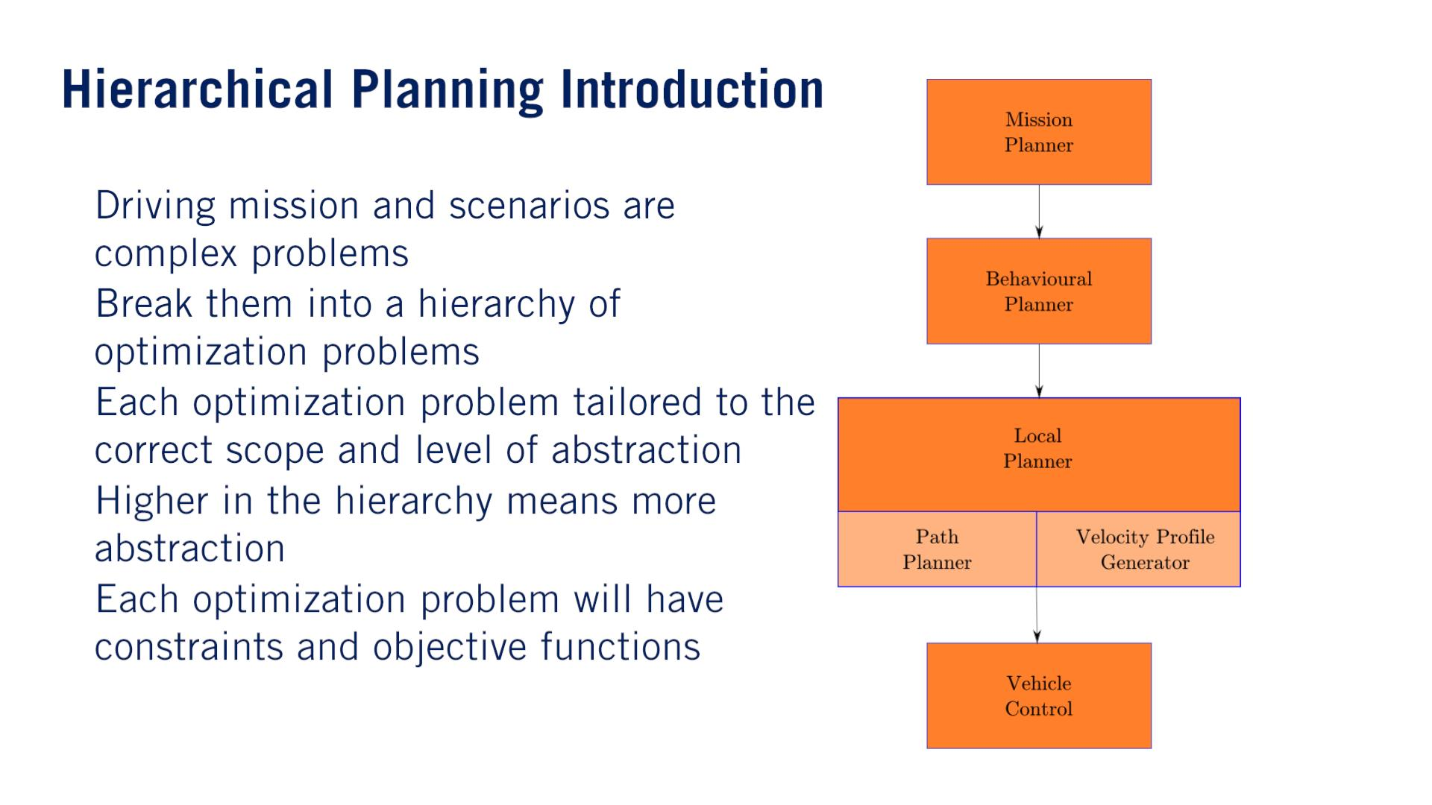
階層的
Navigate to the destination at the map level.
•
•
•
•
•
Depending on its current driving scenario.
Useful driving behaviors include speed tracking, deceleration, and yielding（ゆずる）.

Slide 13
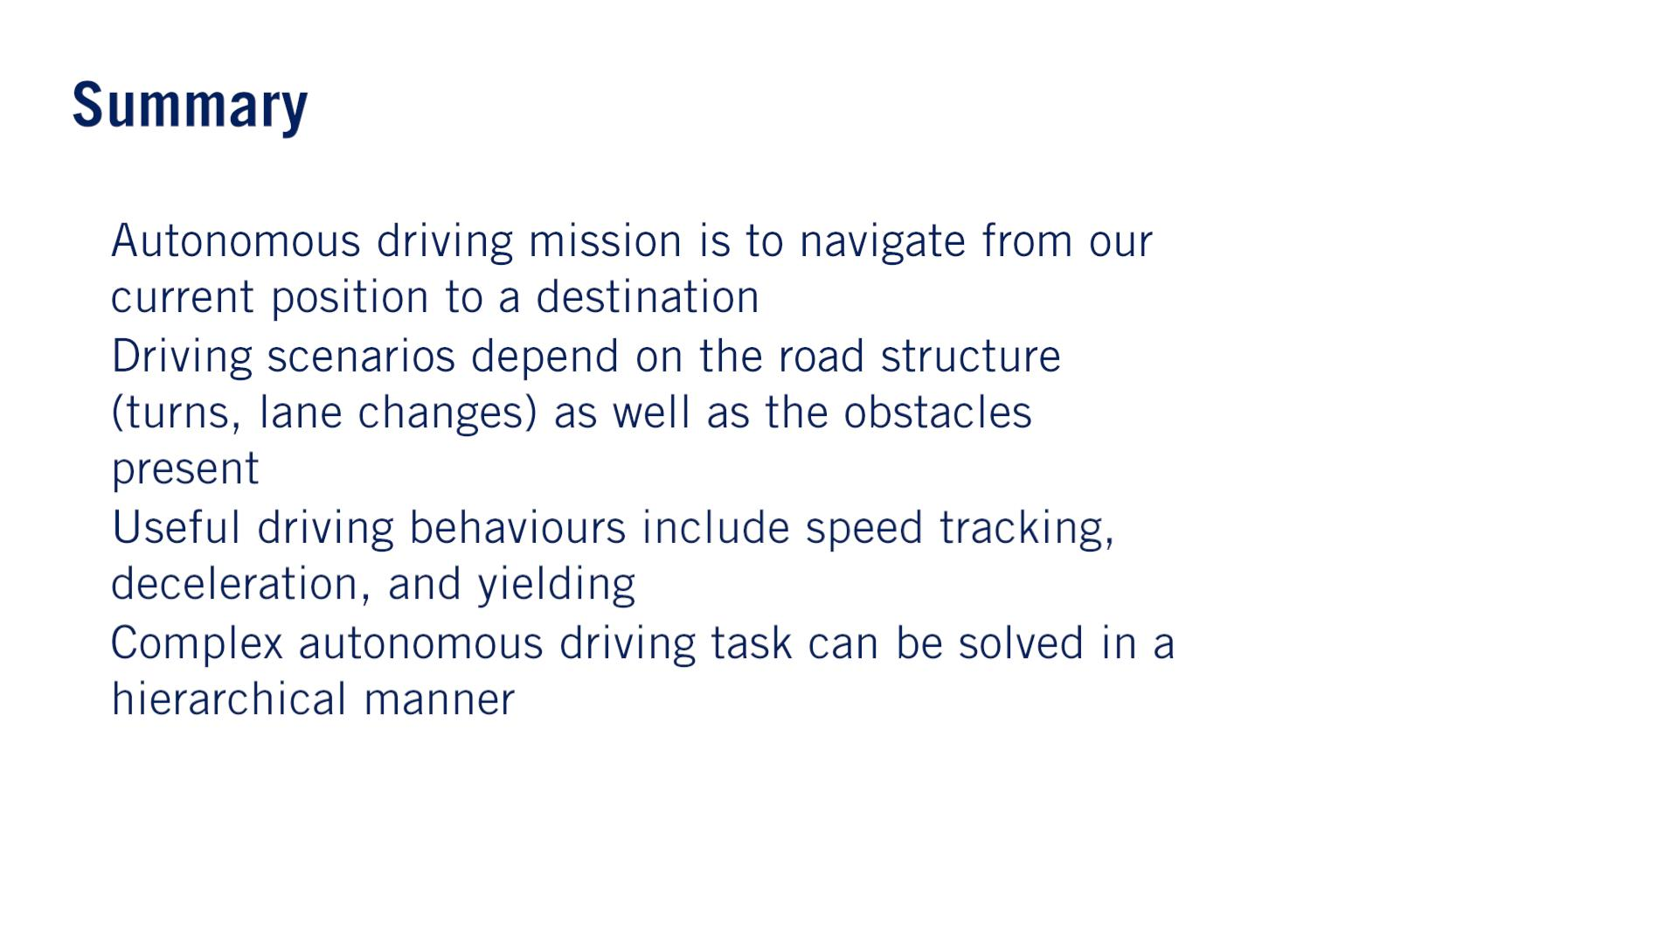
•
•
•
•

Slide 14
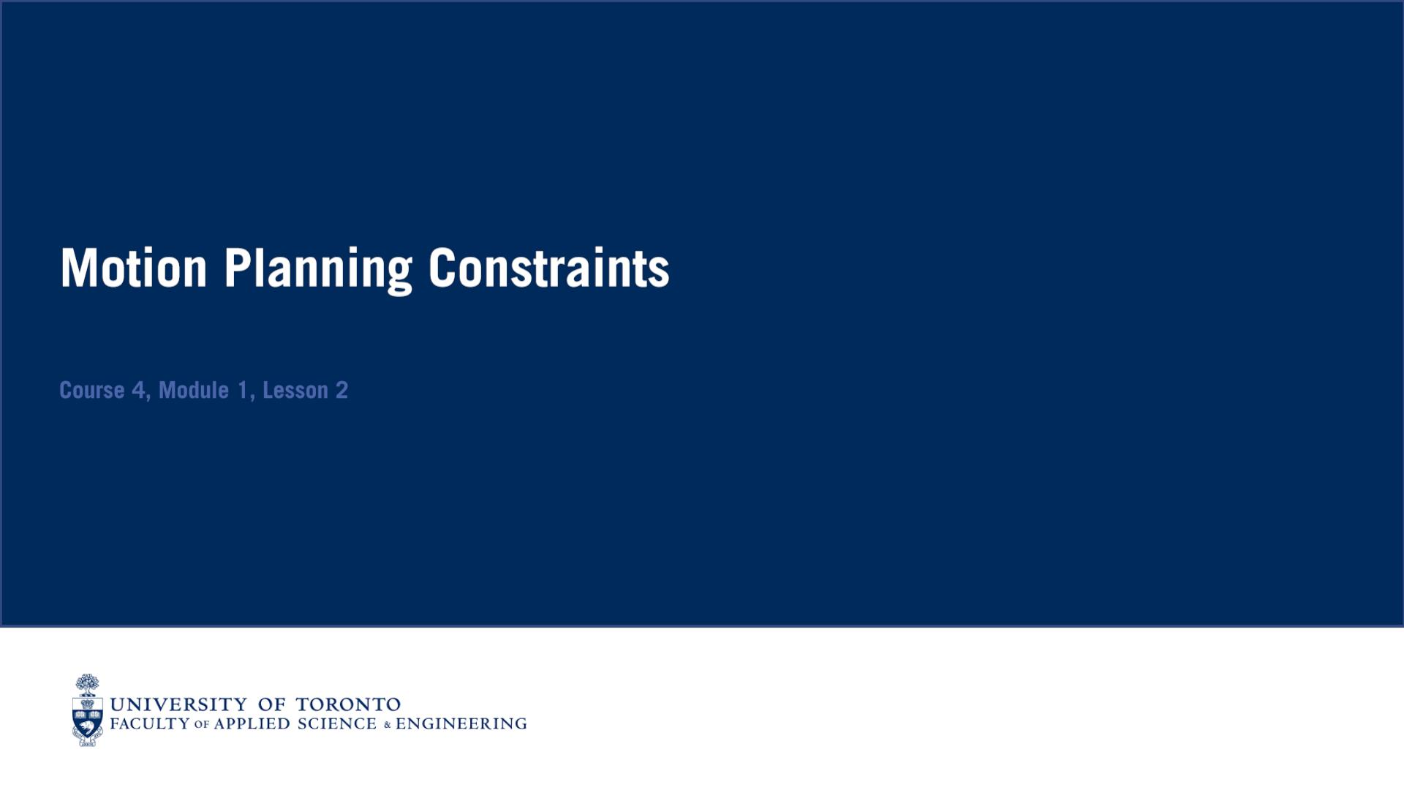
These constraints are often crucial for maintaining stability and comfort within the vehicle, as well as maintaining the safety of all agents in a given driving scenario. こういう意味のConstraintsだ！

Slide 15
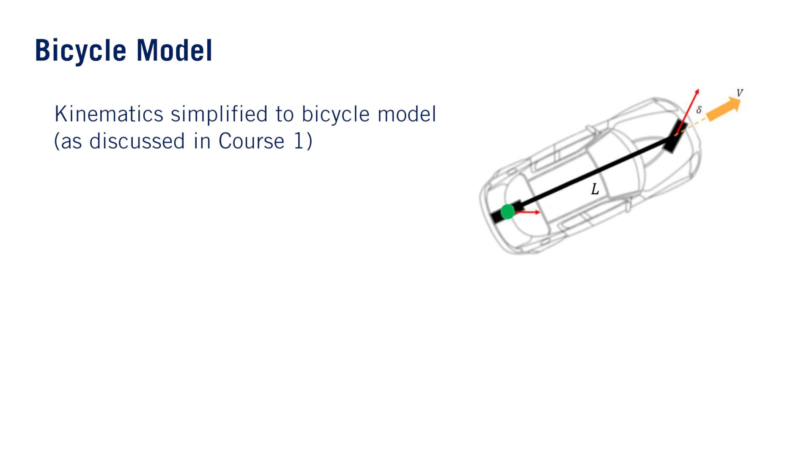
•
One reason why this model is chosen is that bicycles have a range of acceptable steering angle values similar to a car.

Slide 16
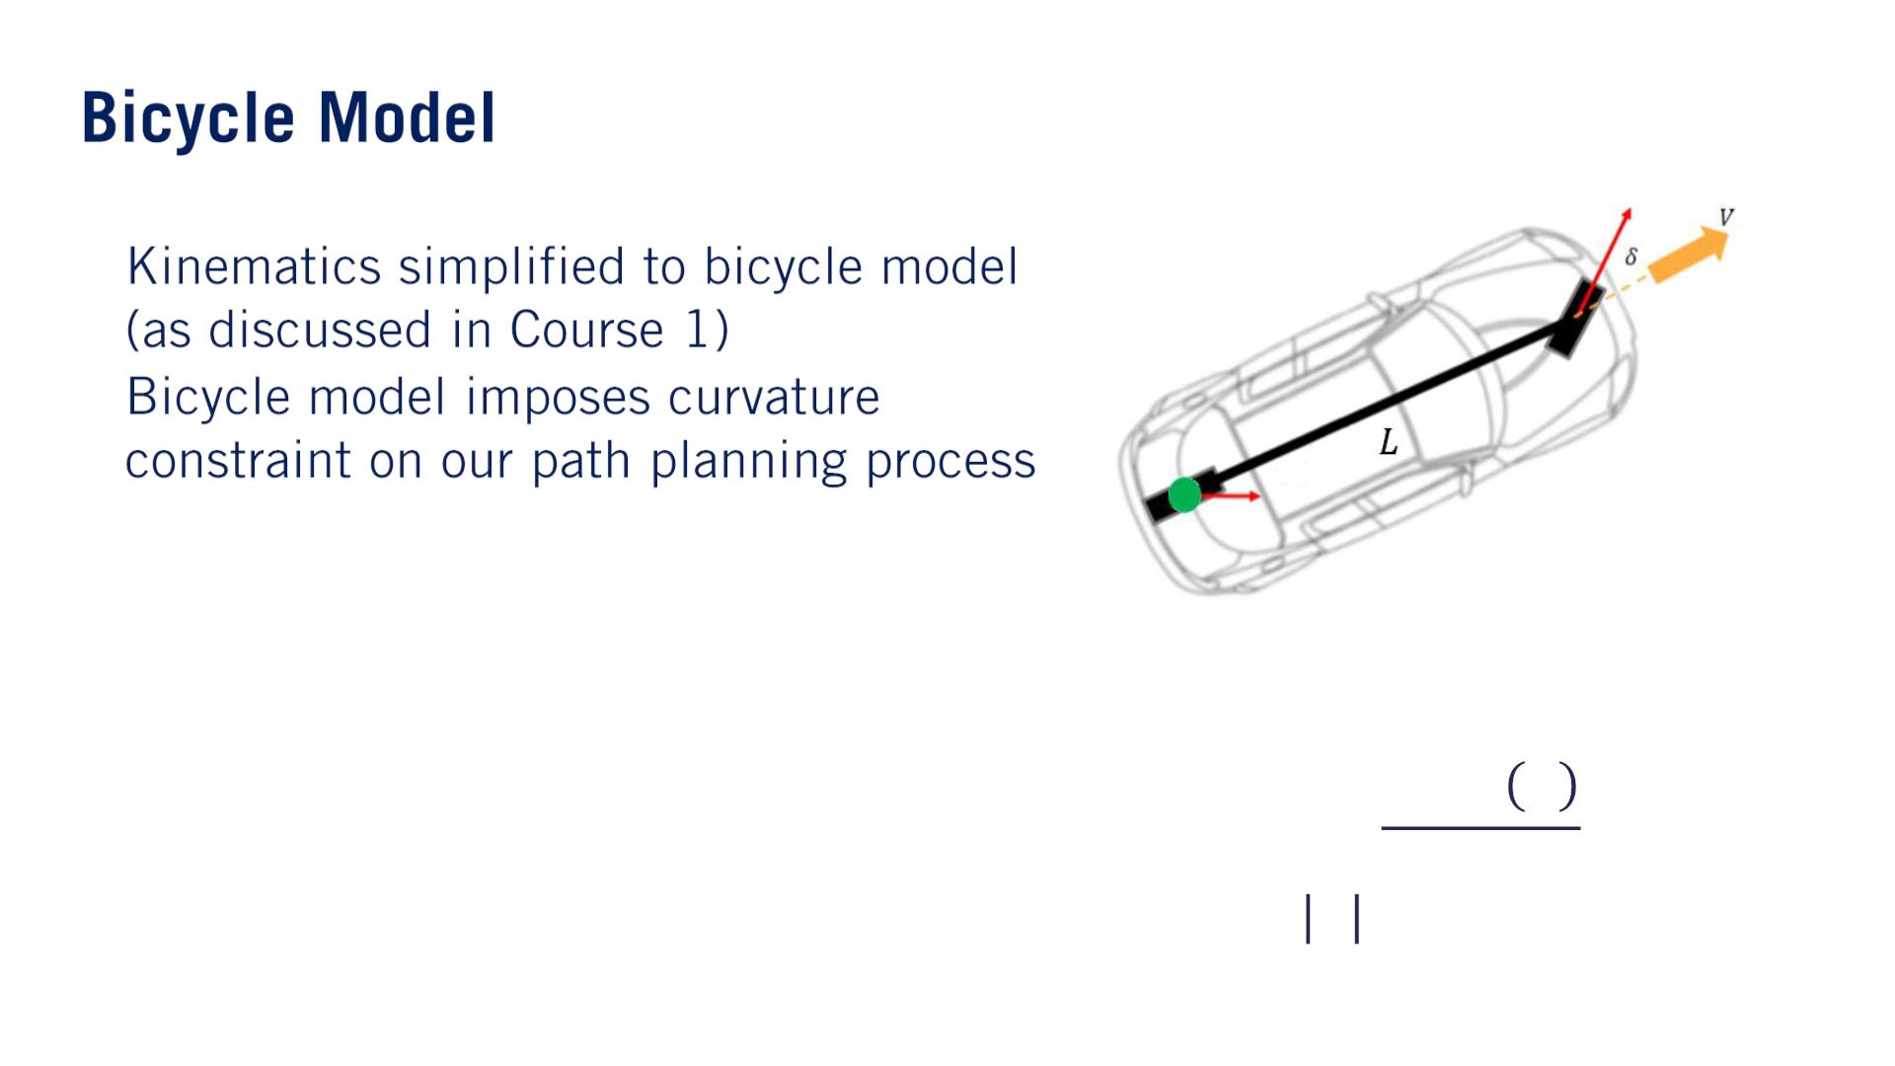
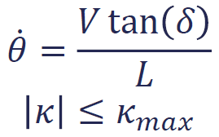
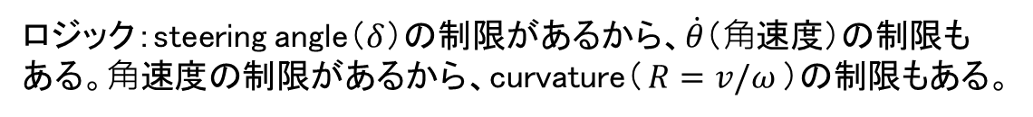
•
•
The curvature of any path we planned needs to be mindful of this maximum curvature.
curvatureの制限
ロジック：steering angle（$δ$）の制限があるから、$\dot{θ}$（⻆速度）の制限もある。⻆速度の制限があるから、curvature（$R=v/ω$）の制限もある。

Slide 17
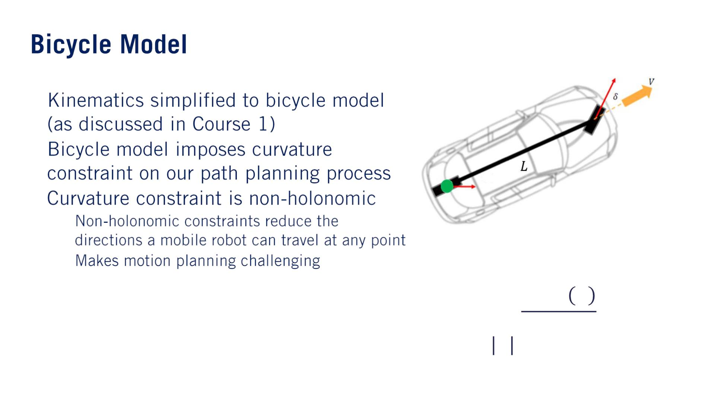
•
•
•
o
o
Non-holonomic: Intuitively, this means that the constraint doesn’t depend only on the state of the robot, but also on how the robot got to its current state.
- つまり前周期も使う。前周期と現在周期の変化量を制限。例えば2輪ロボットの横移動できない。例えば今のままの速度だと、前のカーブ絶対曲がれないので、減速して通る。
푉 tan 훿
퐿
휃 =
휅 ≤ 휅_{푚푎푥}

Slide 18
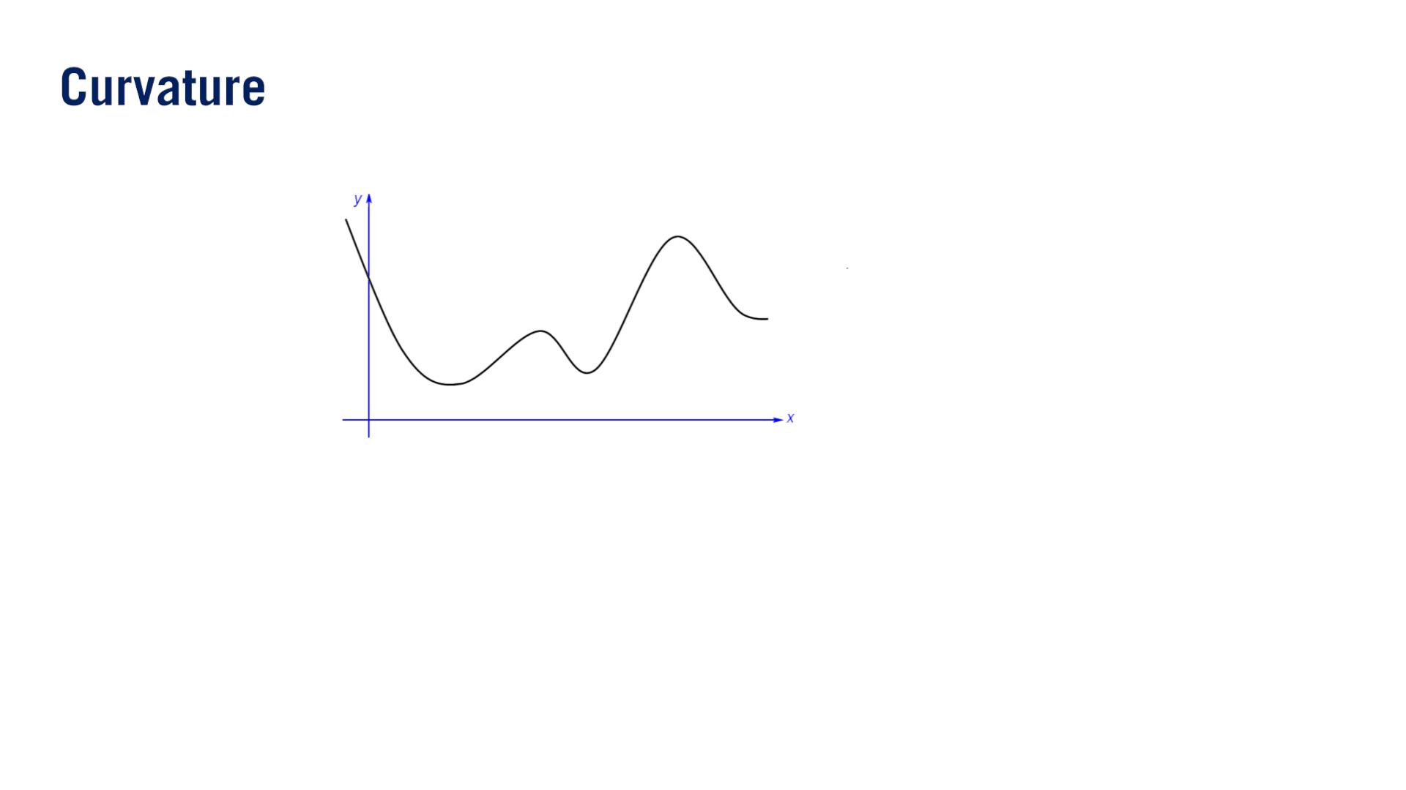

Slide 19
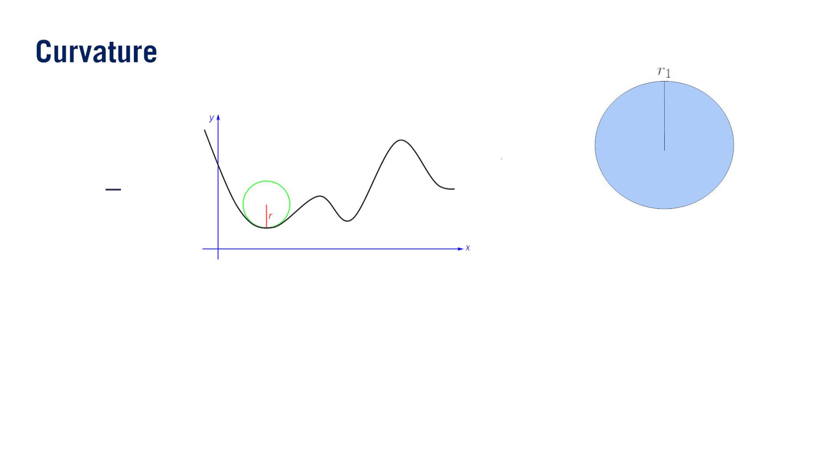
1
푟
휅 =

Slide 20
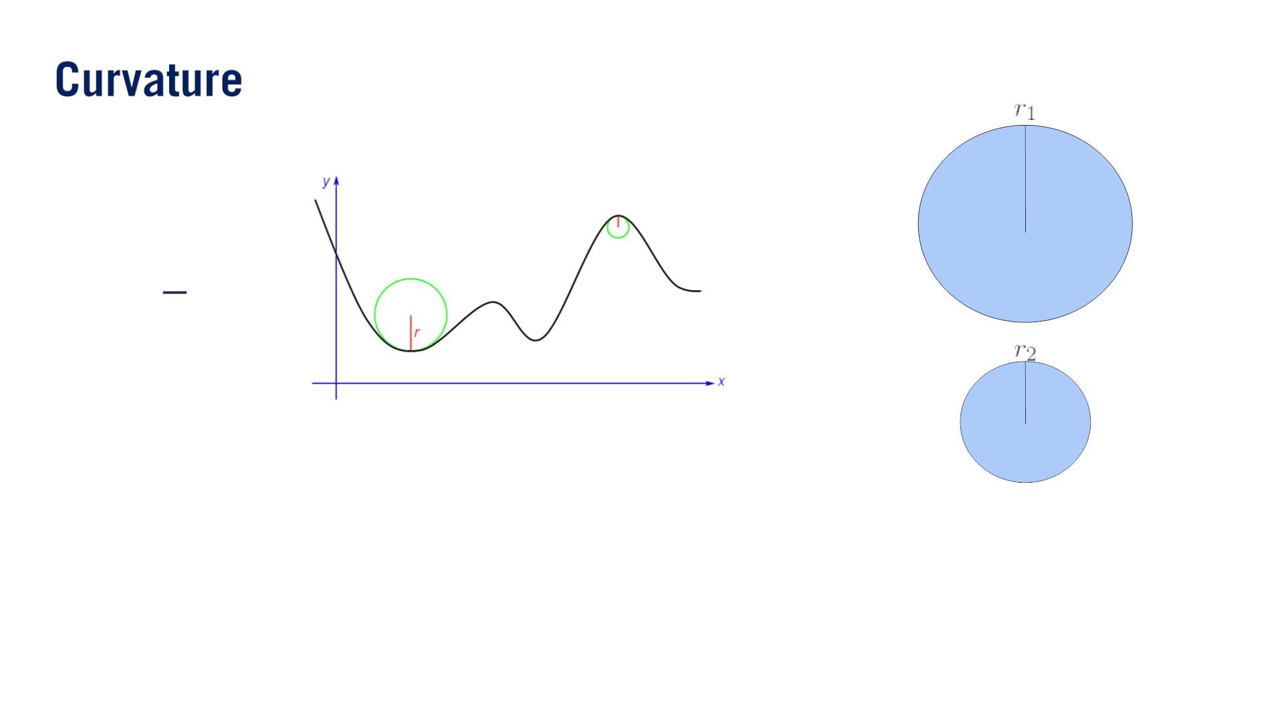
1
푟
휅 =
푟₂ < 푟
1
휅₂ > 휅₁

Slide 21
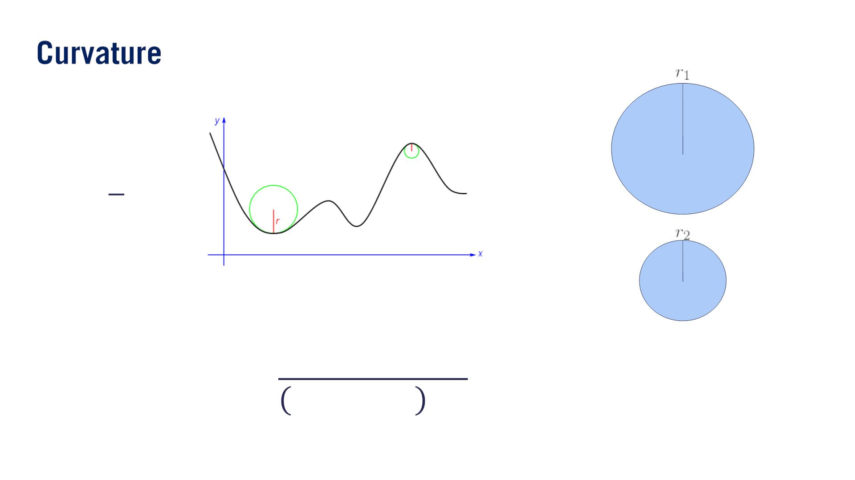
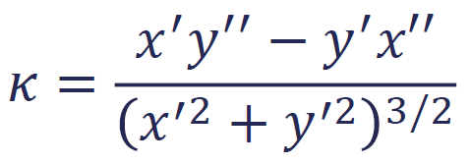
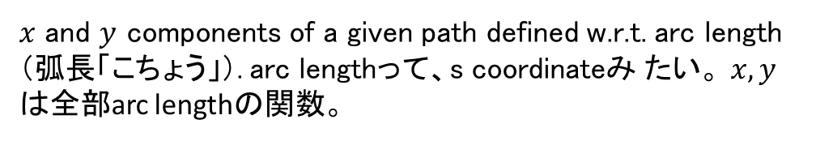
1
푟
휅 =
$x$ and $y$ components of a given path defined w.r.t. arc length（弧長「こちょう」）. arc lengthって、s coordinateみ たい。 $x, y$は全部arc lengthの関数。
푟₂ < 푟
1
휅₂ > 휅₁

Slide 22
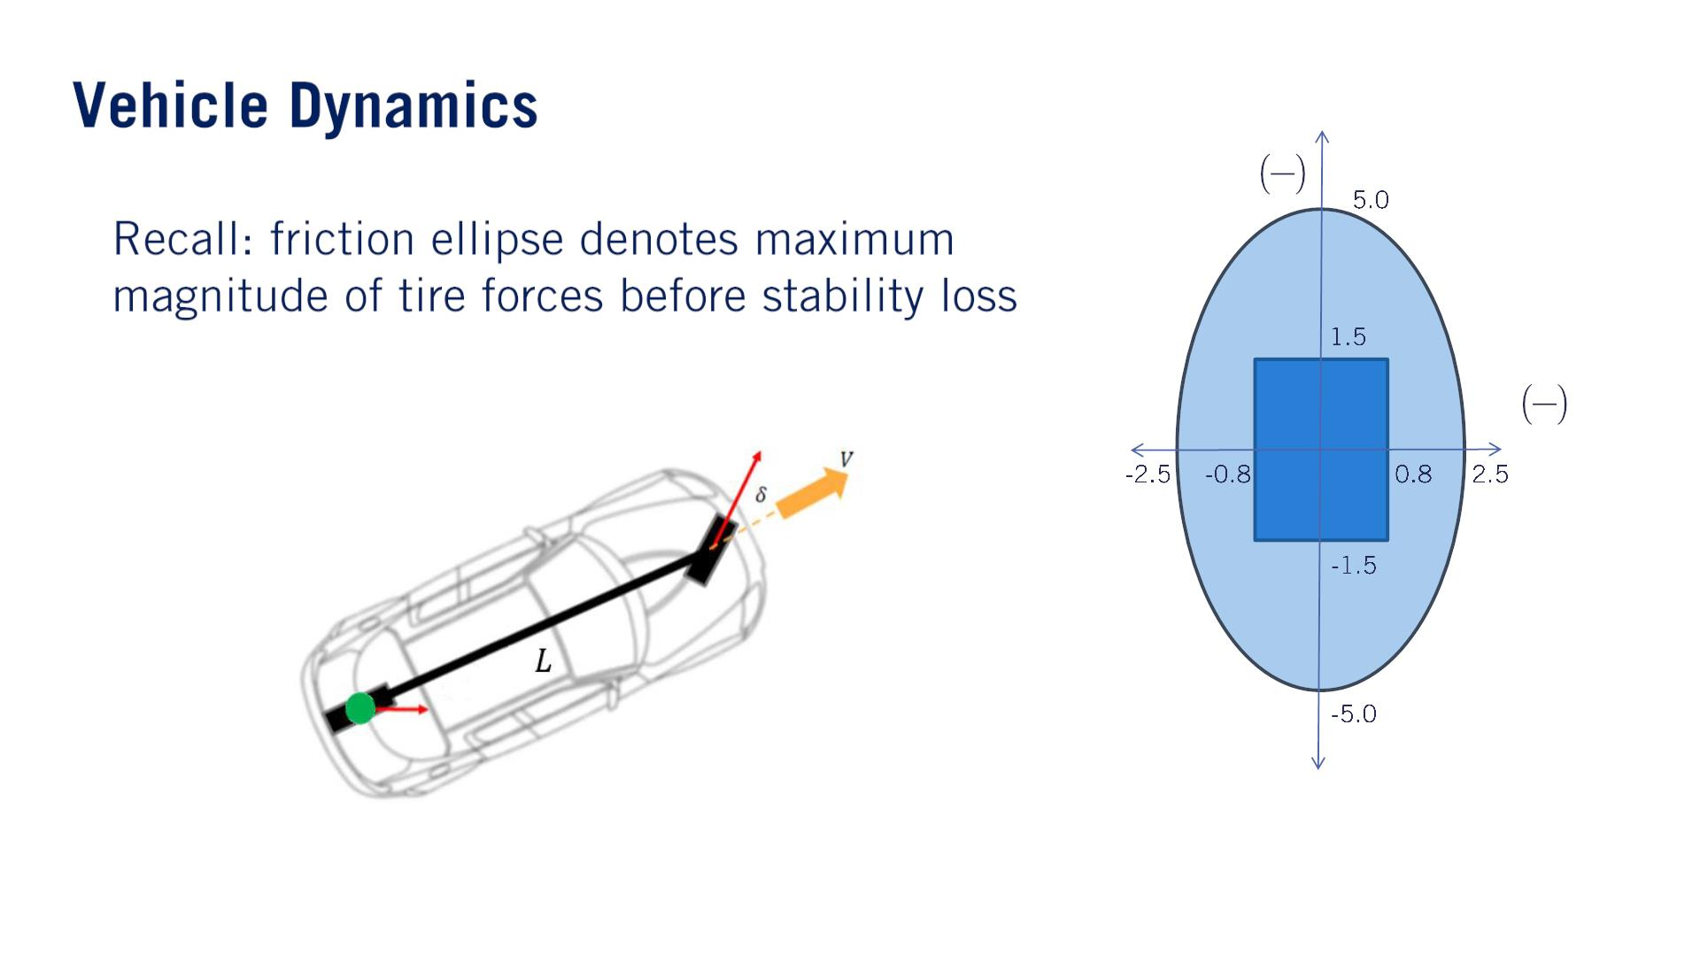
（2種類⽬の制限源）
^{푎}푙표푛푔
푚
푠²
•
The turning functionality of a vehicle relies on the tires gripping（しっかりつかむ） the road surface.
^{푎}푙푎푡
푚
푠²

Slide 23
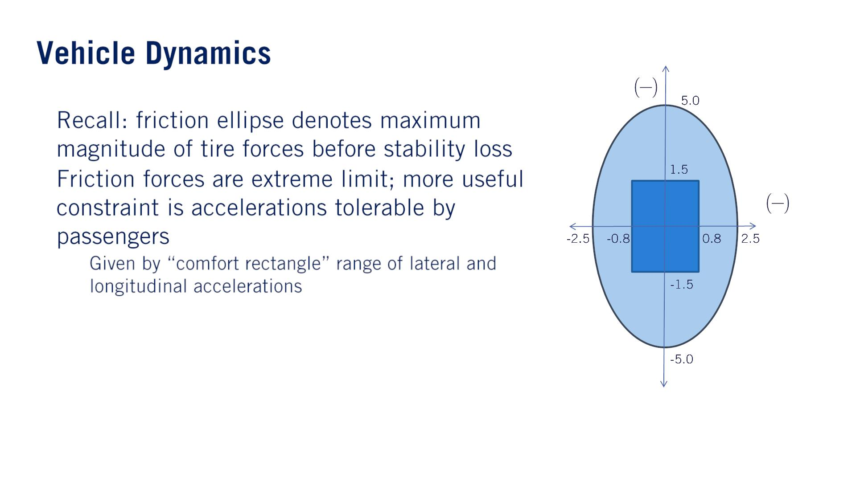
^{푎}푙표푛푔
푚
푠²
•
•
^{푎}푙푎푡
푚
푠²
長方形
o

Slide 24
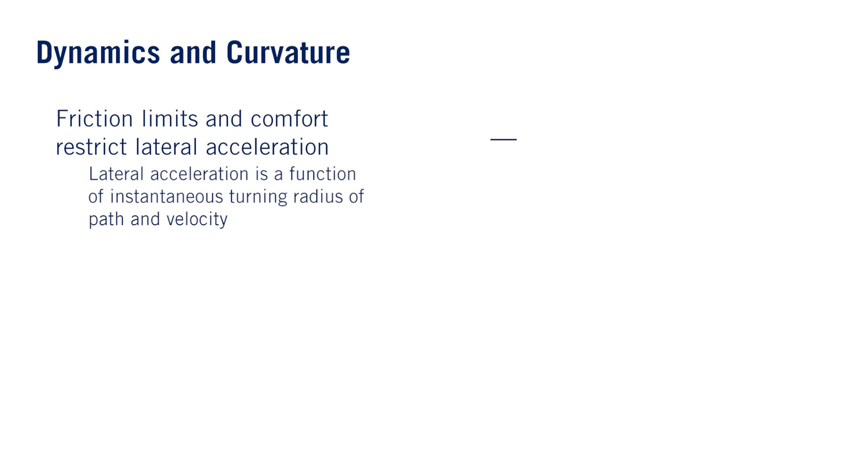
•
2
푎 = , 푎 ≤푎
푣
푙푎푡
푟
푙푎푡
푙푎푡_{푚푎푥}
o

Slide 25
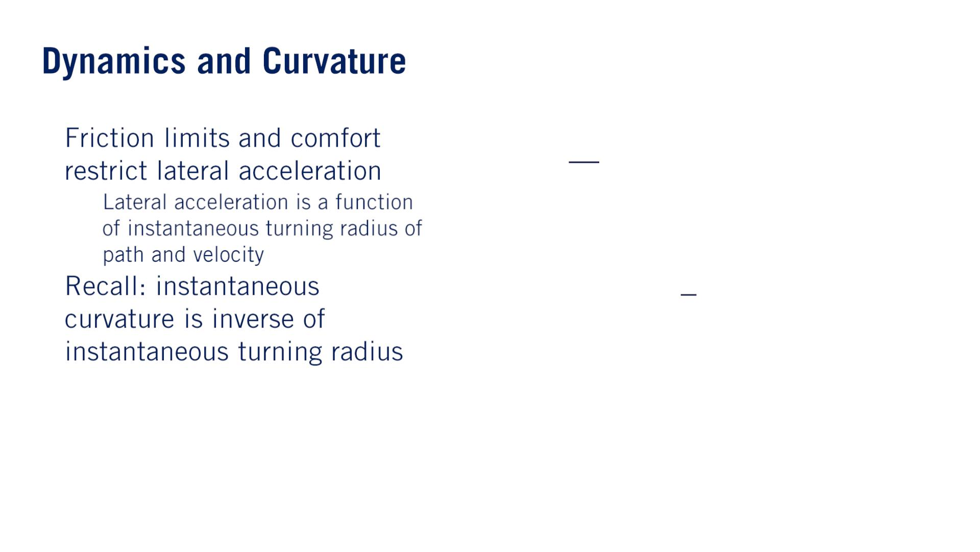
•
•
2
푎 = , 푎 ≤ 푎
푣
푙푎푡
푟
푙푎푡
푙푎푡_{푚푎푥}
o
1
푟
휅 =

Slide 26
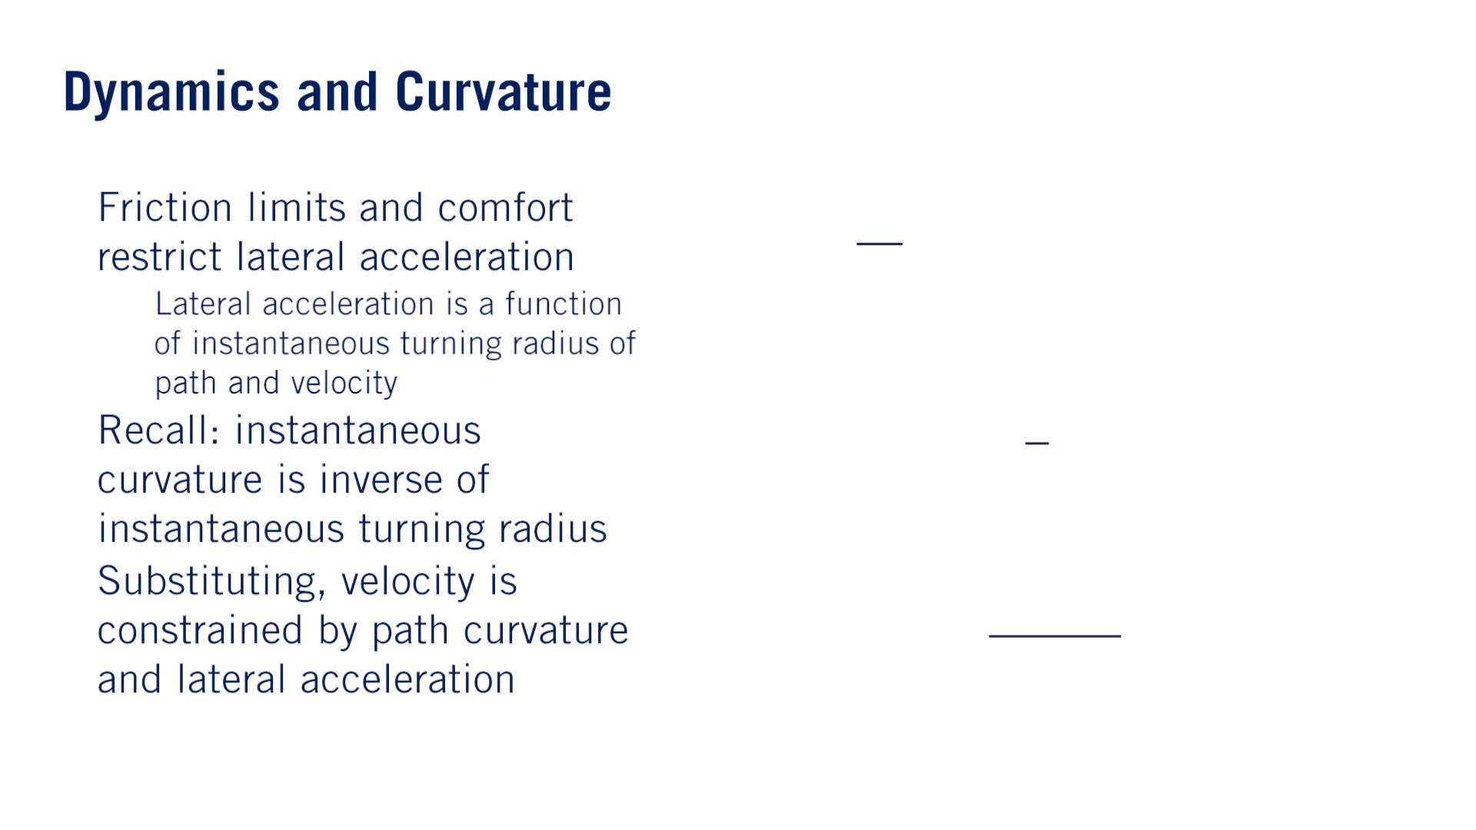
•
2
푎 = , 푎 ≤ 푎
푣
푙푎푡
푟
푙푎푡
푙푎푡_{푚푎푥}
o
1
푟
•
•
휅 =
^{푎푙푎푡}푚푎푥
_{푣}2 ≤
휅
$κ$はchanges at each point along the path.
Because of this, it’s clear that when we are generating a velocity profile for our autonomous vehicle, we have to take the curvature of the path as well as the vehicle’s maximum lateral acceleration into consideration.

Slide 27
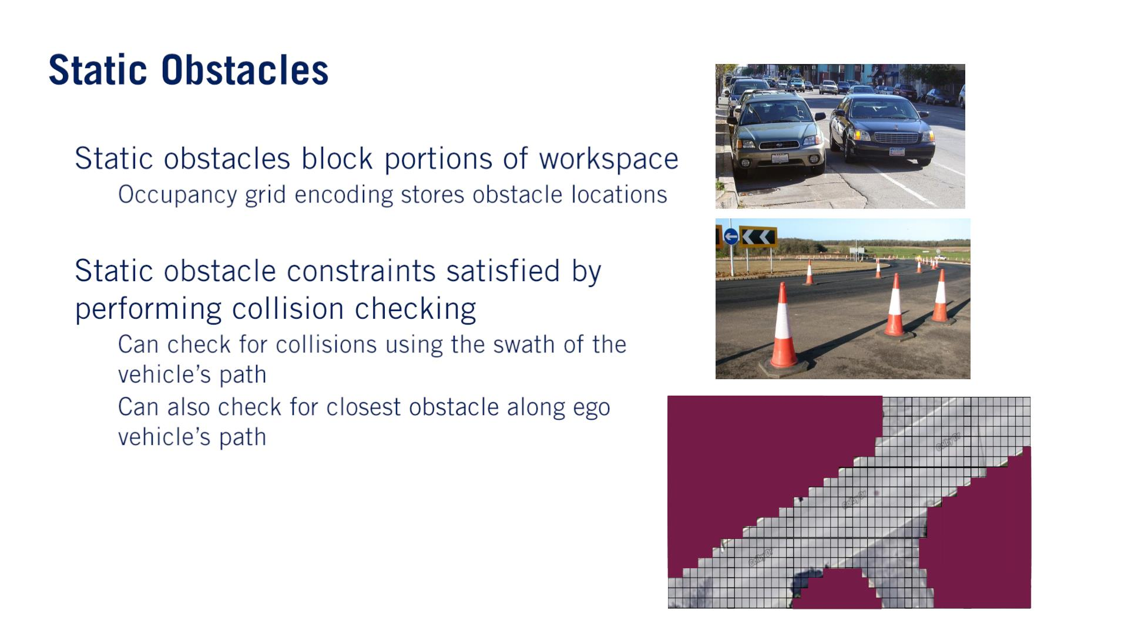
•
•
o
o
o

Slide 28
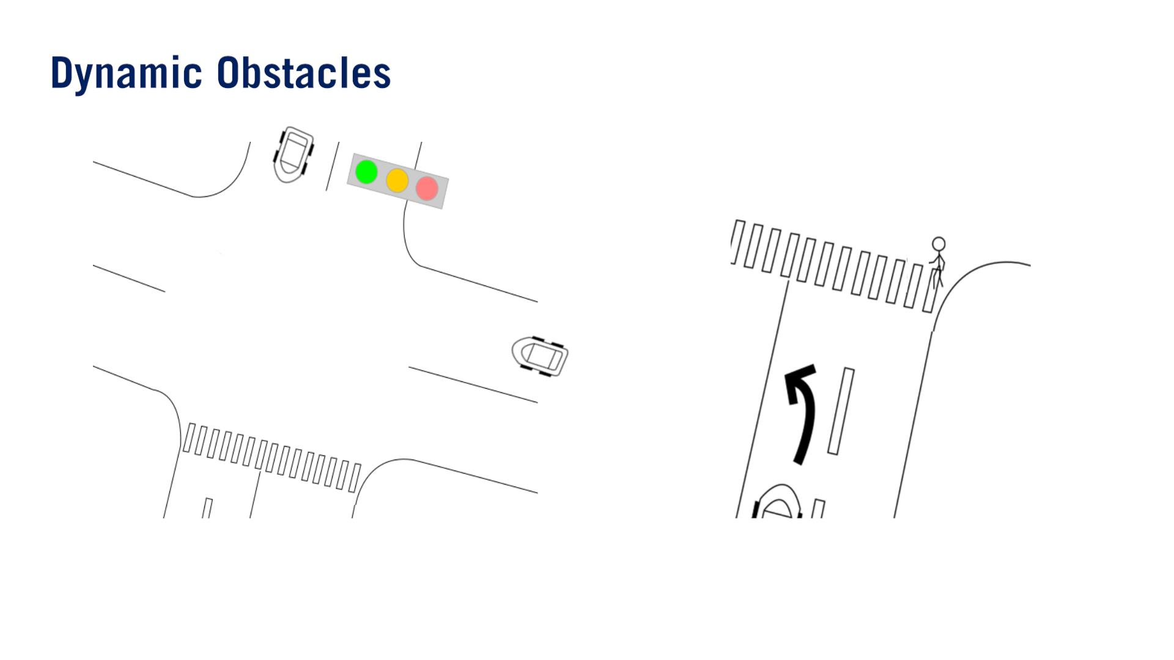
Constraining our motion plan based on the behavior of these other agents will often involve prediction, which is subject to uncertainty.
However, if we take the conservative approach and constrain ourselves to all possible behaviors of all agents, our motion planning problem quickly becomes over-constrained and impossible to solve meaningfully.
The degree to which we balance between the safety of conservatism and the aggressiveness required for forward progress, is an active area of autonomous driving research.
Dynamic obstacles will constrain both our behavior planning process, where we make maneuver decisions, as well as our local planning process, where it will affect our velocity profile planning.

Slide 29
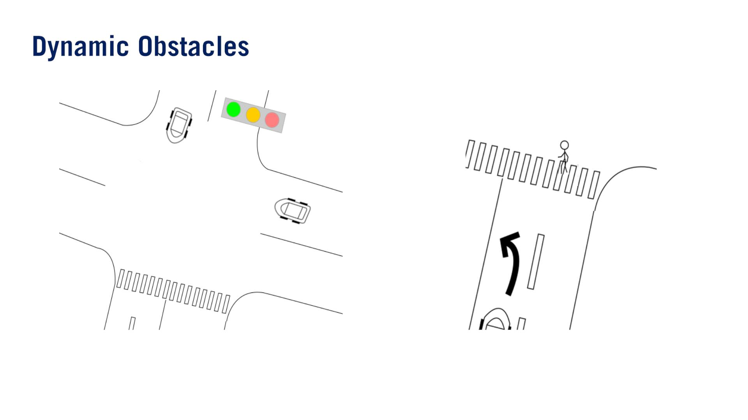

Slide 30
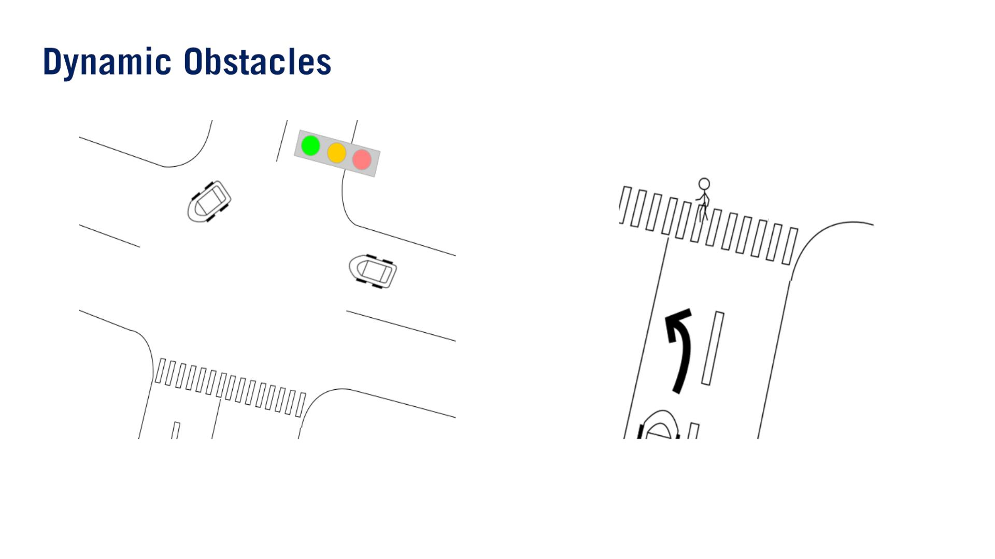

Slide 31
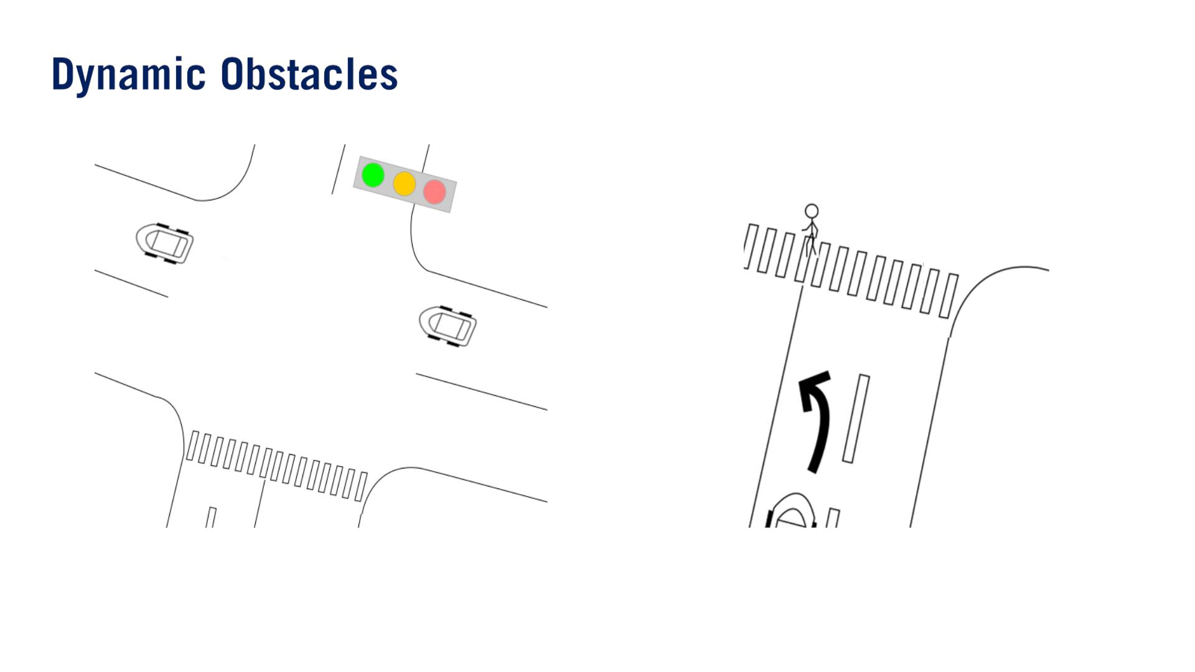

Slide 32
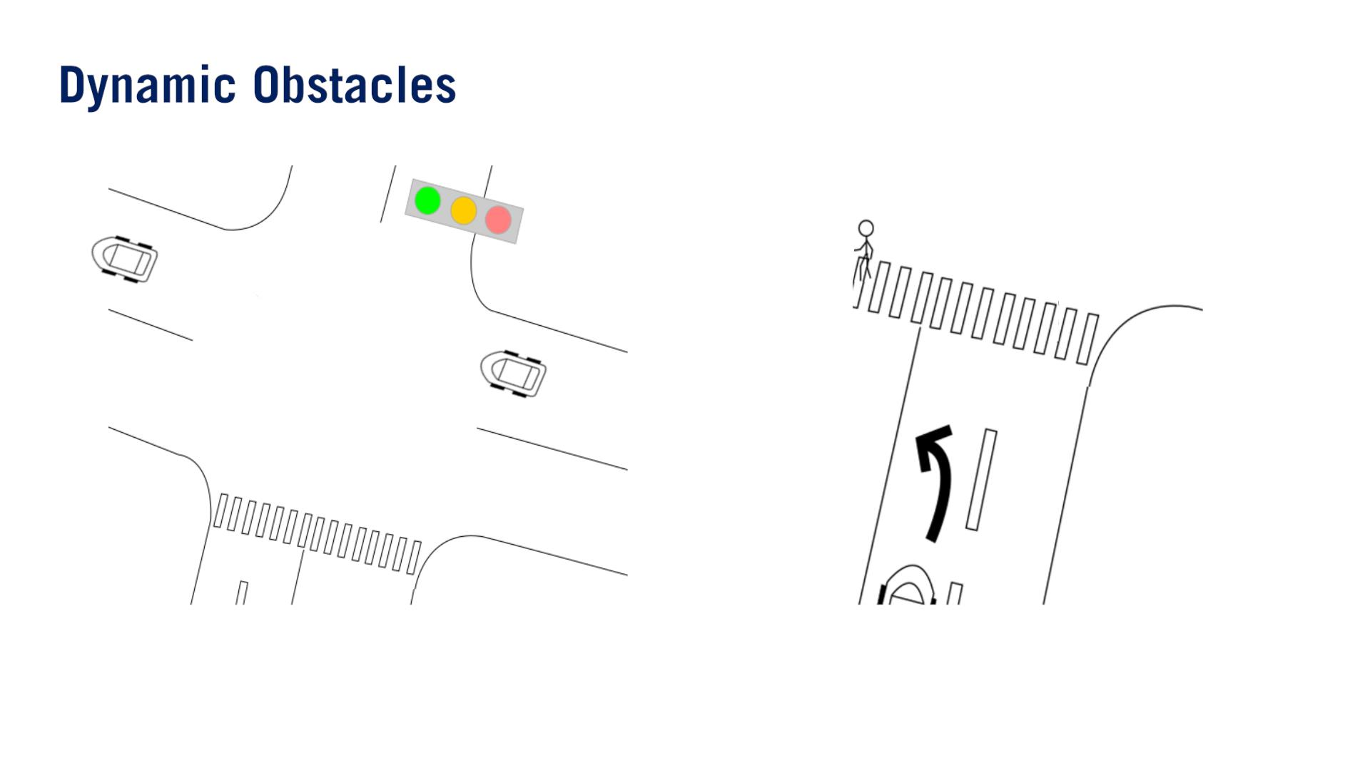

Slide 33
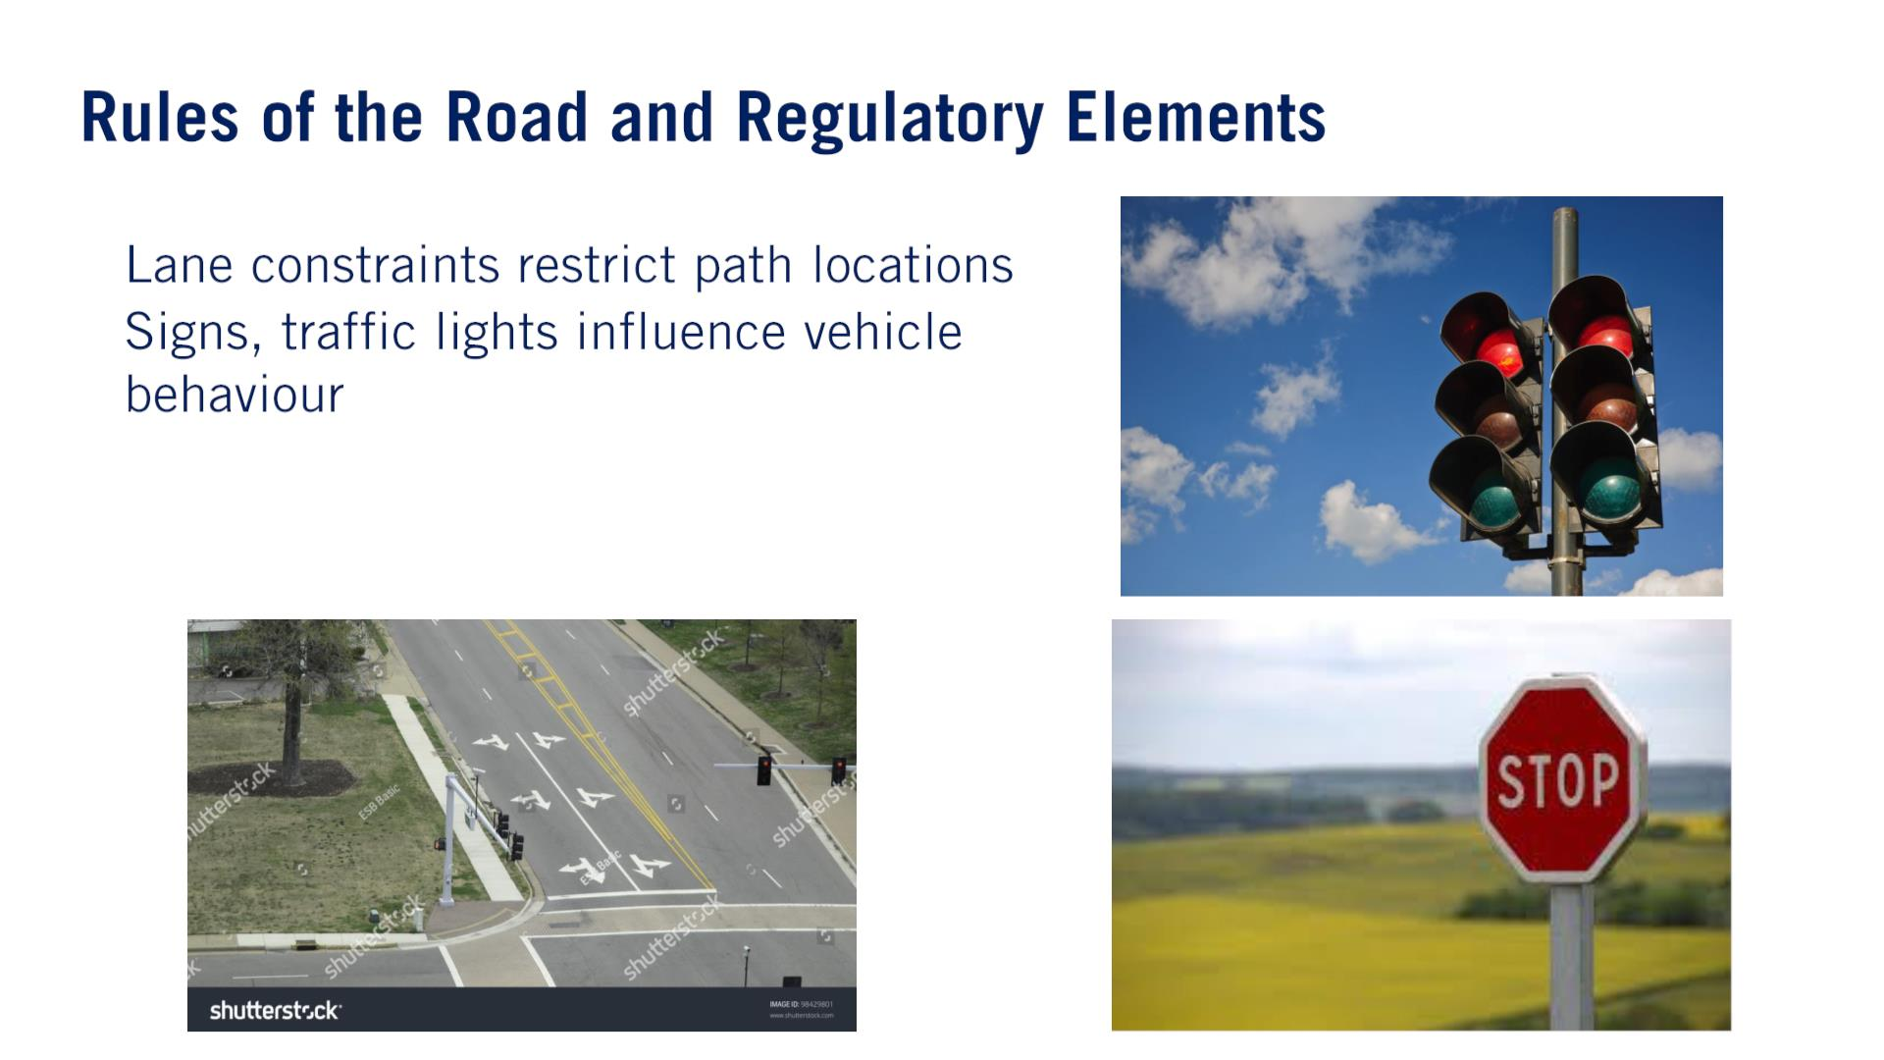
•
•
While the rules of the road provides some constraints to the planning problem, they also help us make informed（知識のある） decisions about other agents’ behaviors in the environment.
For example, oncoming traffic is highly likely to stay in its lane, and not try to collide with our ego vehicle head on.
This can help reduce the search space when trying to predict what other agents will do.

Slide 34
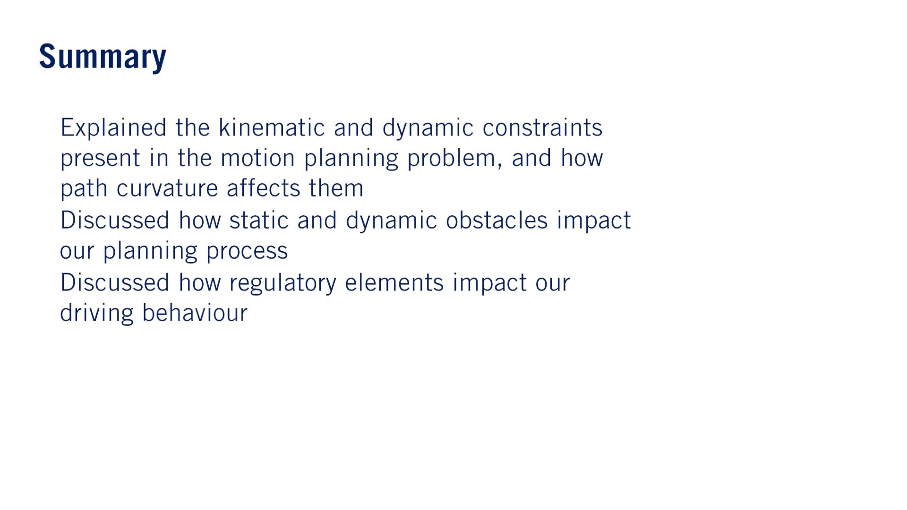
•
•
•

Slide 35
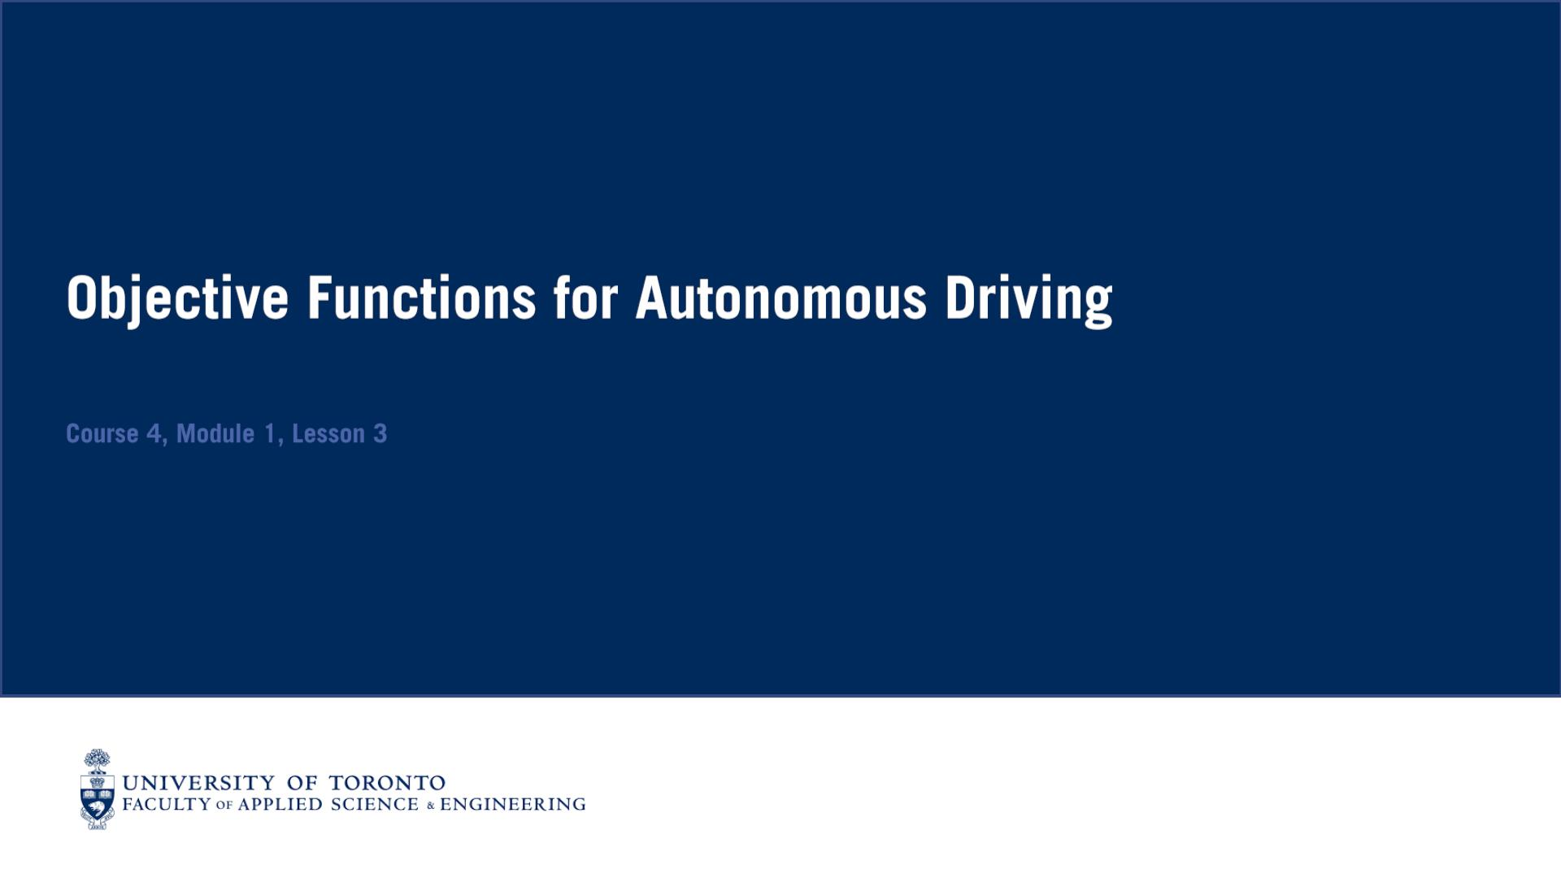
In this context, the objective function of our motion planning problem gives us a way of scoring our current motion plan, and allows us to optimize the motion plans such that it has desirable characteristics.

Slide 36
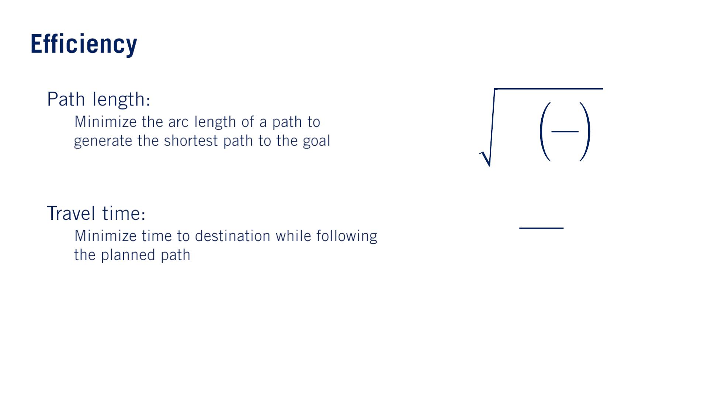
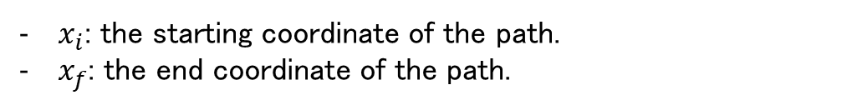
•
•
푥_{푓}
푠_{푓} = න
2
푑푦
o
o
1 +
푑푥
푥_{푖}
푑푥
$x_{i}$: the starting coordinate of the path.
$x_{f}$: the end coordinate of the path.
^{푠}푓
1
푇_{푓} = න
푑푠
푣(푠)
0

Slide 37
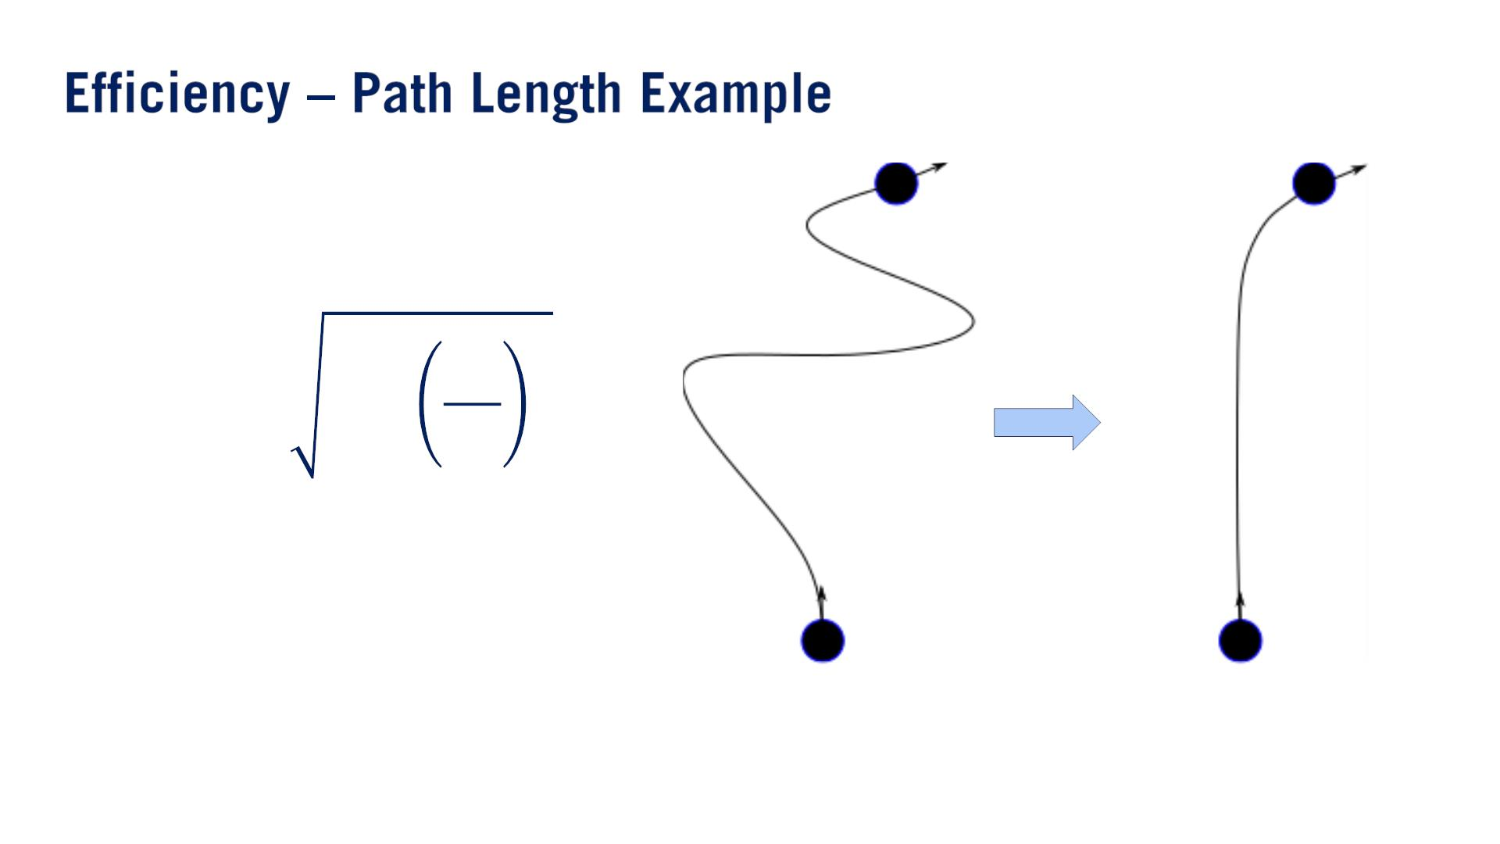
푥_{푓}
푠_{푓} = න
2
푑푦
1 +
푑푥
푥_{푖}
푑푥

Slide 38
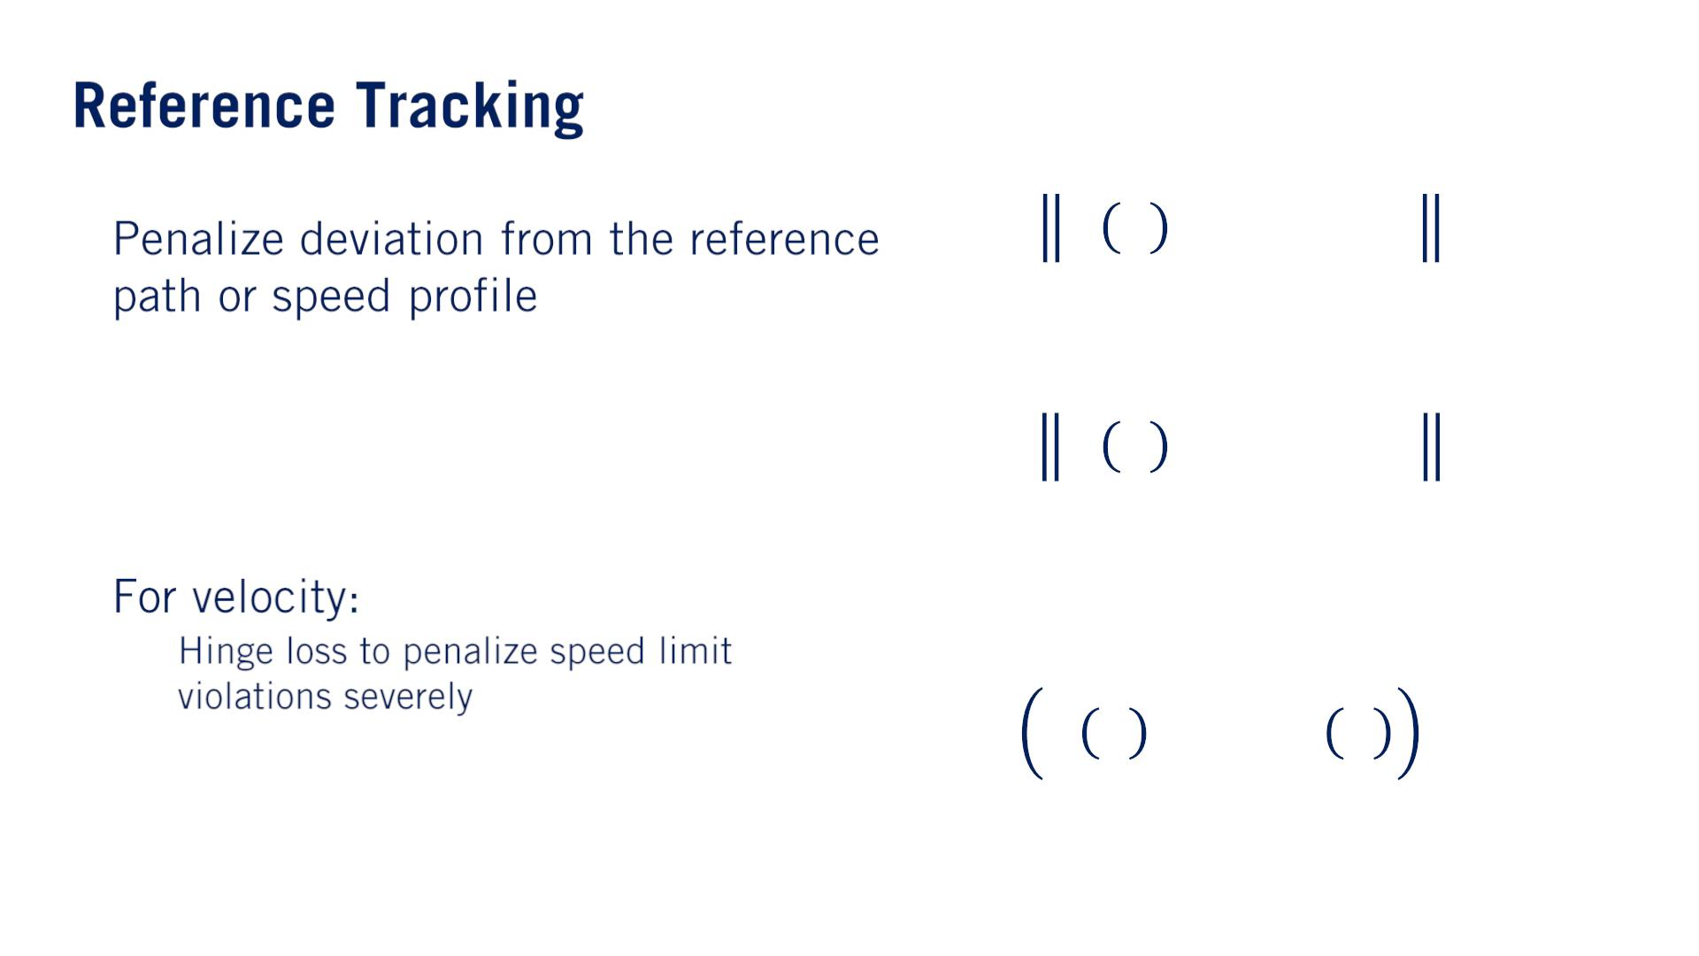
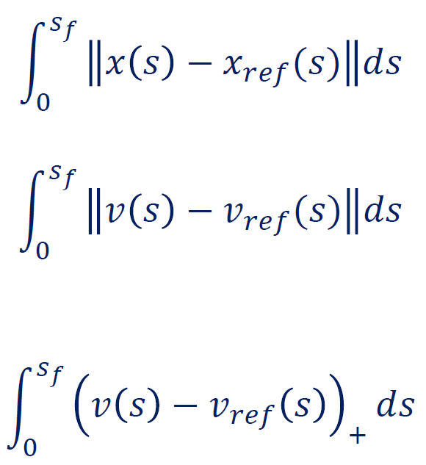
In many cases, this will be given to us by the mapping module as the center line of a lane, or the required path for a turn in an intersection.
•
•
Integral of Difference (IOD) term.
It is often the case that we want to penalize exceeding speed limits more harshly than staying below the speed limit.
o
Essentially, this term is only active when the velocity profile exceeds the speed limit, that is when the difference between our speed and the speed limit is positive, otherwise this term is zero.

Slide 39
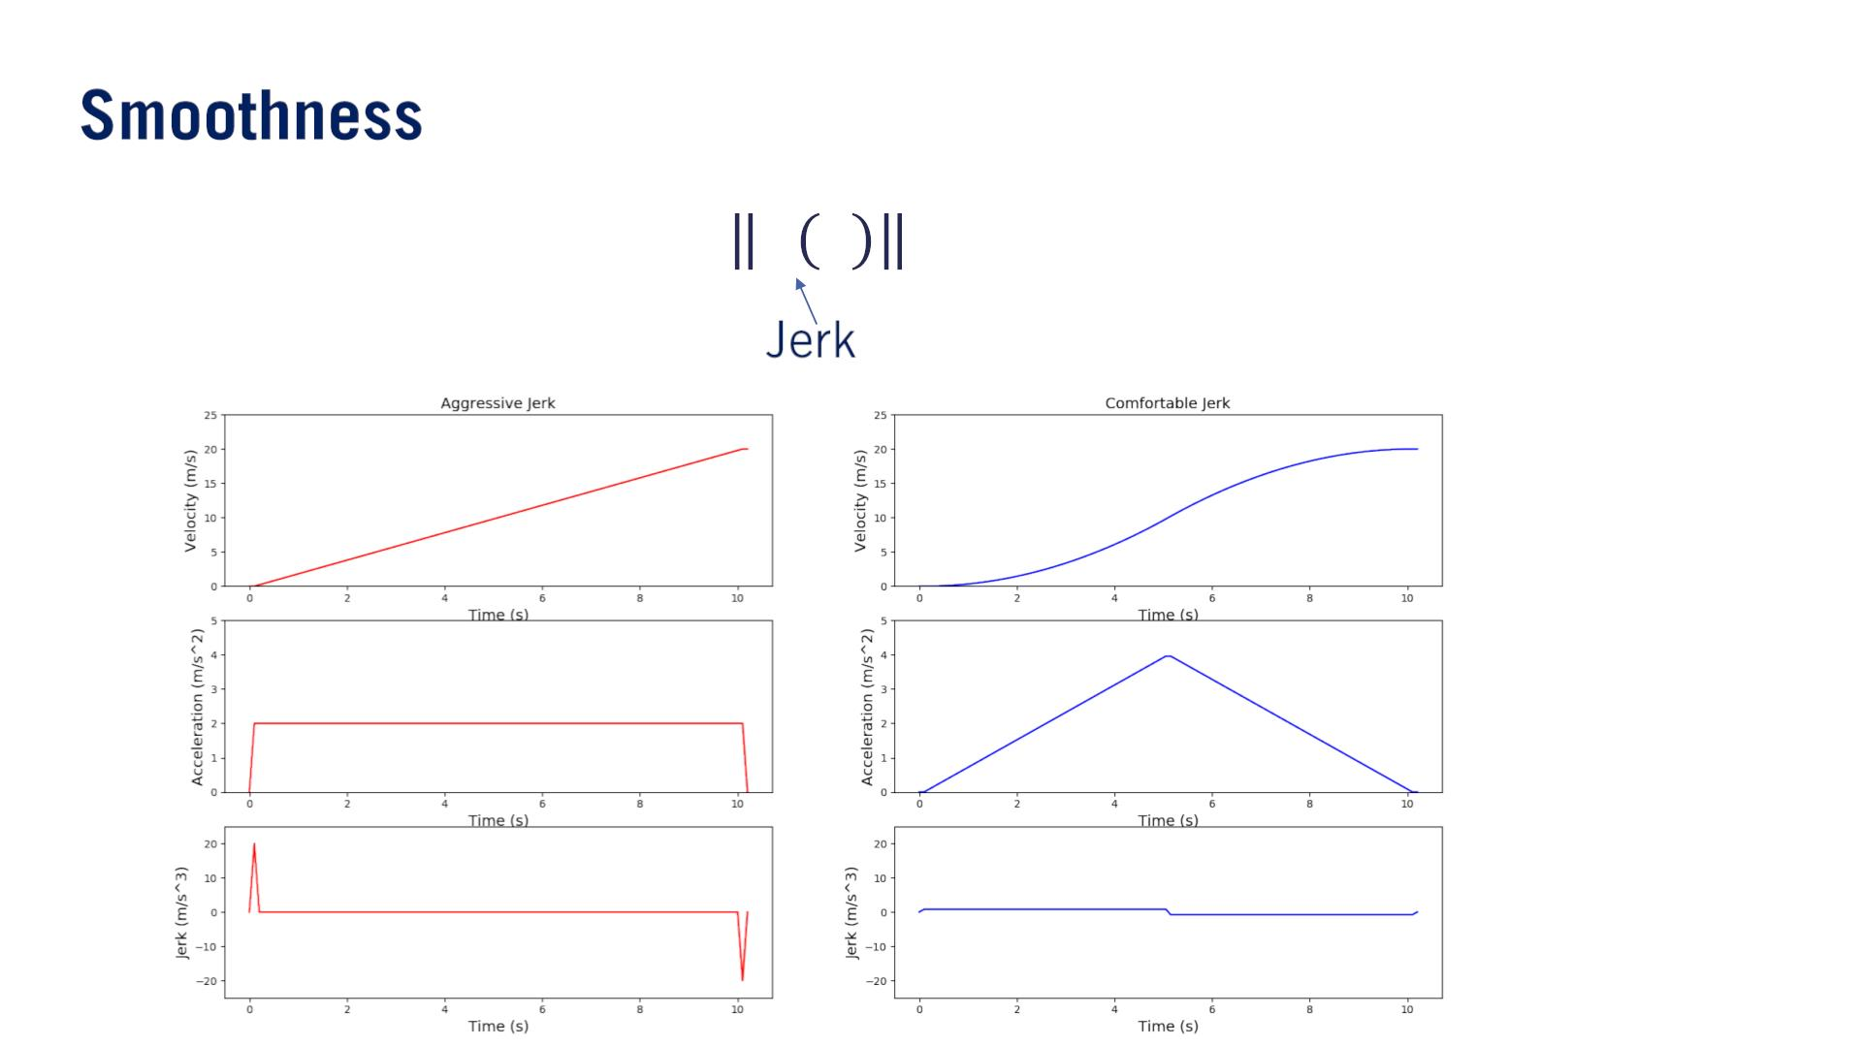
The jerk along the car’s trajectory greatly impacts the user’s comfort while in the car.
So when planning our velocity profile, we would like to keep the accumulated absolute value of jerk as small as possible.
When optimizing comfort in the objective function of our velocity profile, minimizing the jerk along the trajectory:
^{푠}푓
න 푥ഺ 푠 ²푑푠
0
左：linear ramp profile
右：biquadratic（of or relating to the fourth power） profile

Slide 40
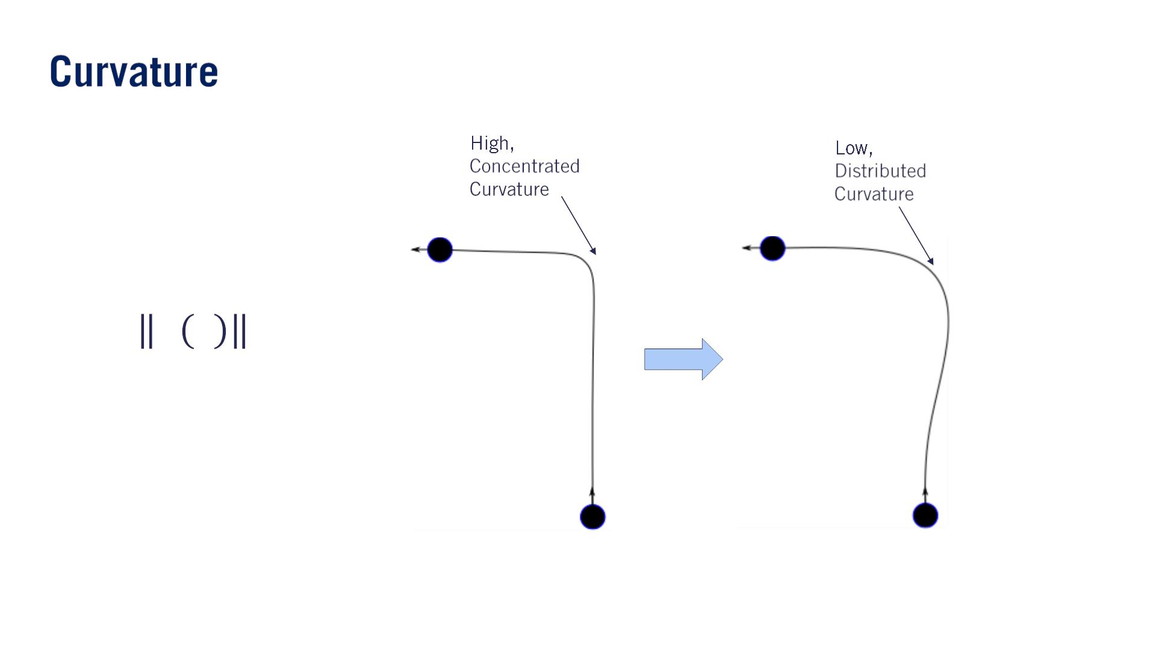
Bending energy(曲げエネルギ) of the path:
^{푠}푓
න 휅 푠 ²푑푠
0
強いcurvatureを避ける。またcurvatureが強いと、 減速もしないといけない。
L2 Normなので、1つ強いcurvatureを複数緩いcurvaturesへのdistributionを促す。
This objective distributes the curvature more evenly（均等に） along the path, preventing any one along the path from reaching too high a total curvature value.

Slide 41
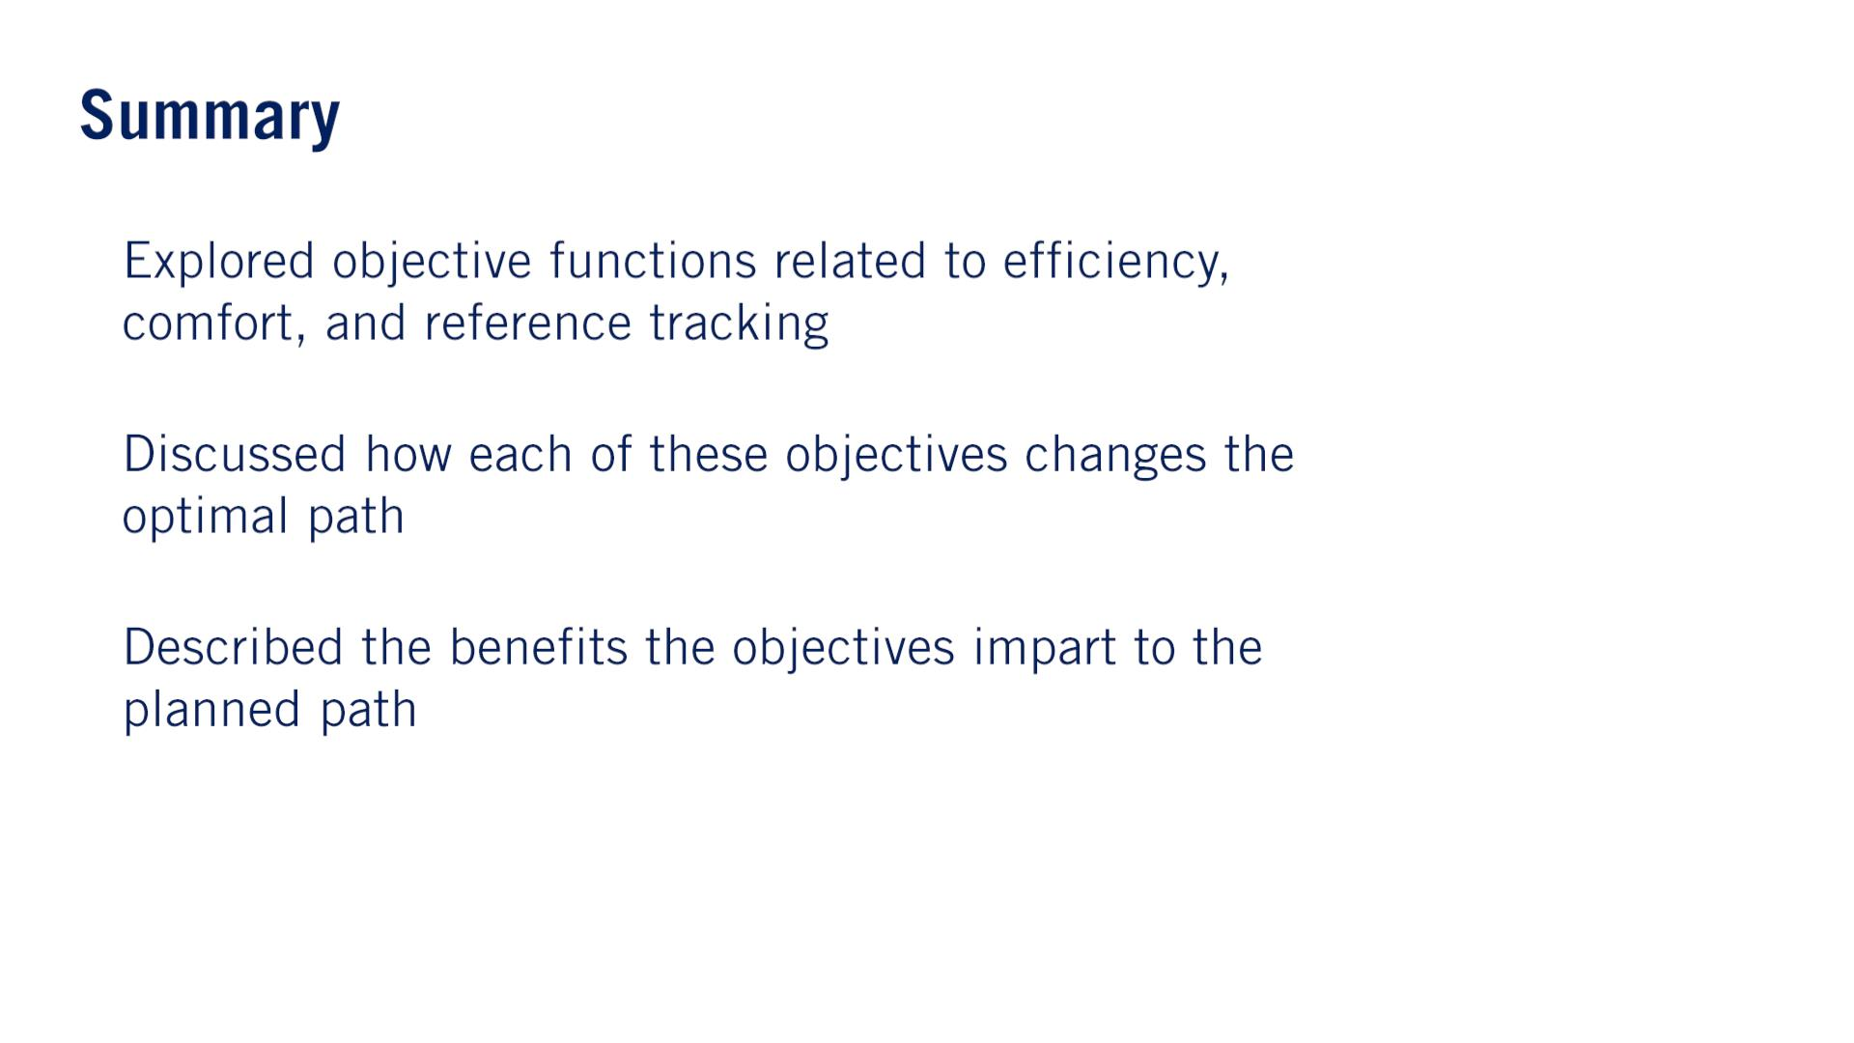
•
•
•
与える

Slide 42
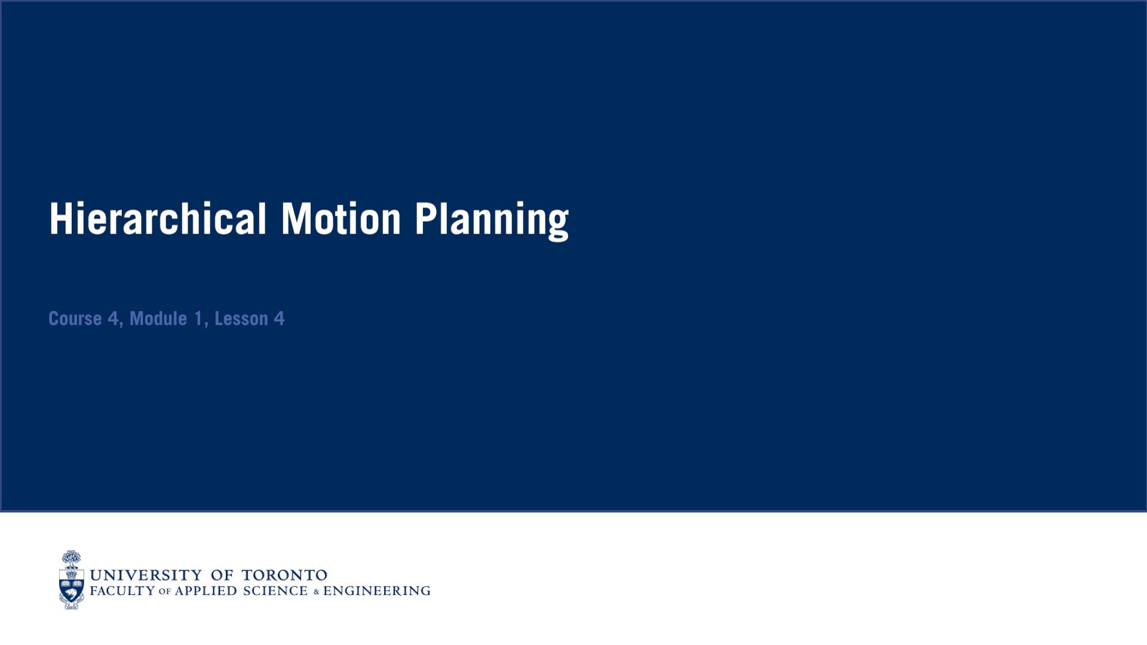

Slide 43
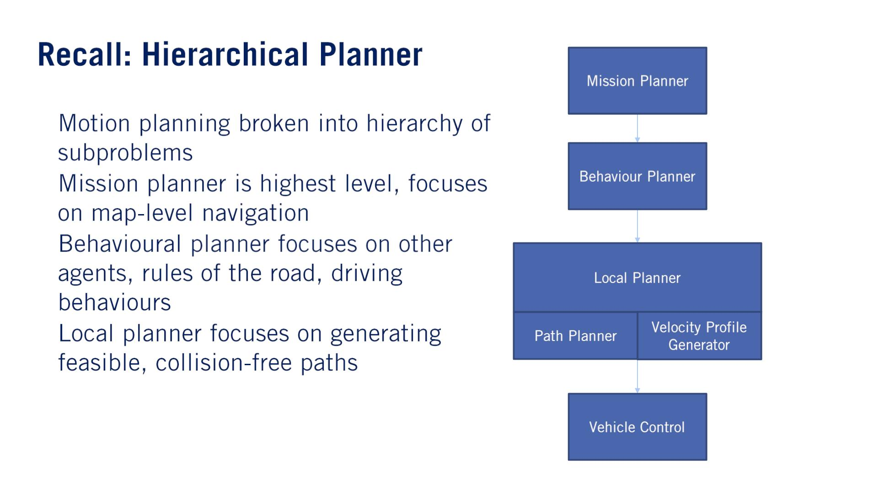
•
•
•
•

Slide 44
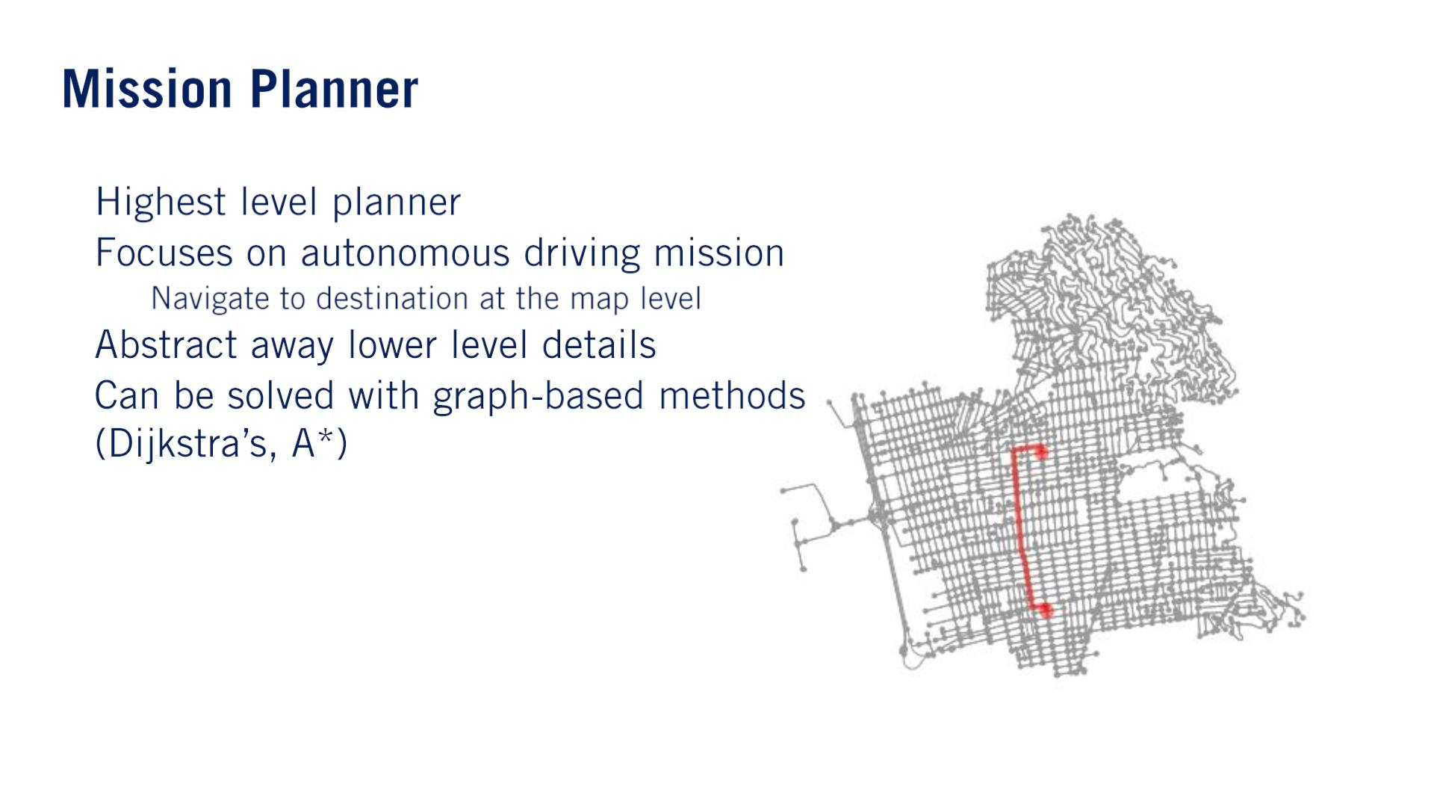
•
•
o
•
•

Slide 45

•
•
•

Slide 46

（Matlabの簡易モデルはこういうタイプでしょう）
•
•
o
o
States
▪
o
Transitions

Slide 47

•
•
o
•
o
o
∧
∧
→
→
It is both important and challenging to make sure rule-based systems are logically consistent.

Slide 48


（⼤事、勉強しよう）
The reward function values the quality of a given chain of actions for all time steps discounting future states more heavily than the present. （$t$が上がると、$γ^{t}$が下がる）
∞
푡
푅 = ෍ 훾 푅 (푠 , 푠 )
푎 푡 푡+1
푡
푡=0
푎_{푡}
훾 ∈ [0,1)
The process of reinforcement learning requires the agent to perform actions in an environment often given by simulation.
This agent is then rewarded according to its interaction（インタラクション） with the environment.
Which then allows it to converge to an optimal policy through successive interactions.

Slide 49

•
•
The key ingenuity（創意工夫） behind developing a good path planning algorithm is reducing the search space for optimization.
Three main categories of path planners: sampling-based planners, variational（変分） planners and lattice（格子） planners.

Slide 50

•
•
•
When run in a short number of cycles.
この種類のアルゴリズムの１つ：
Rapidly Exploring Random Tree, or RRT and its variance.
Construct the branches of the tree of paths by generating points in randomly sampled locations and planning a path to the point, from the nearest point in the tree.
If the path is free from collisions with any static obstacles, that path is added to the tree.
Exploring Random Tree (RRT)
This tree quickly explores the workspace with many potential paths and when a goal region is reached, the path that terminates in that region is returned.

Slide 51

N. Ratliff, M. Zucker, J. A. Bagnell, and S. Srinivasa, “CHOMP: Gradient optimization techniques for efficient motion planning,” 2009 IEEE International Conference on Robotics and Automation, 2009. Introduces the CHOMP algorithm as an example of applying calculus of variations to planning.
変分法
Variational planners are usually trajectory planners, which means they combine both path planning and velocity planning into a single-step.

Slide 52

Obstacles can set edges that cross them to infinite cost, so the graph search allows us to perform collision checking as well.
While the lattice planner is often quite fast, the quality of paths are sensitive to the selected control set.
（⼤事）
•
o
•
•
Goal points are selected some distance ahead of the car, laterally offset from one another w.r.t. the direction of the road and a path is optimized to each of these points.
The path that best satisfies some objective while also remaining collision free is then chosen as the path to execute. - objectiveは例えばarc length, bending energy

Slide 53



Usually set up as a constrained optimization problem.
objectivesは例えば：
•
•
•
^{푠}푓
න 푥ഺ(푠) 푑푠
0
Optimize the velocity profile for a given plan path and reference speed.

Slide 54

•
•
•
•
Lattice Planners論⽂：[2009] Differentially Constrained Mobile Robot Motion Planning in State Lattices. https://ri.cmu.edu/pub_files/2009/3/ross.pdf

